Slide 1
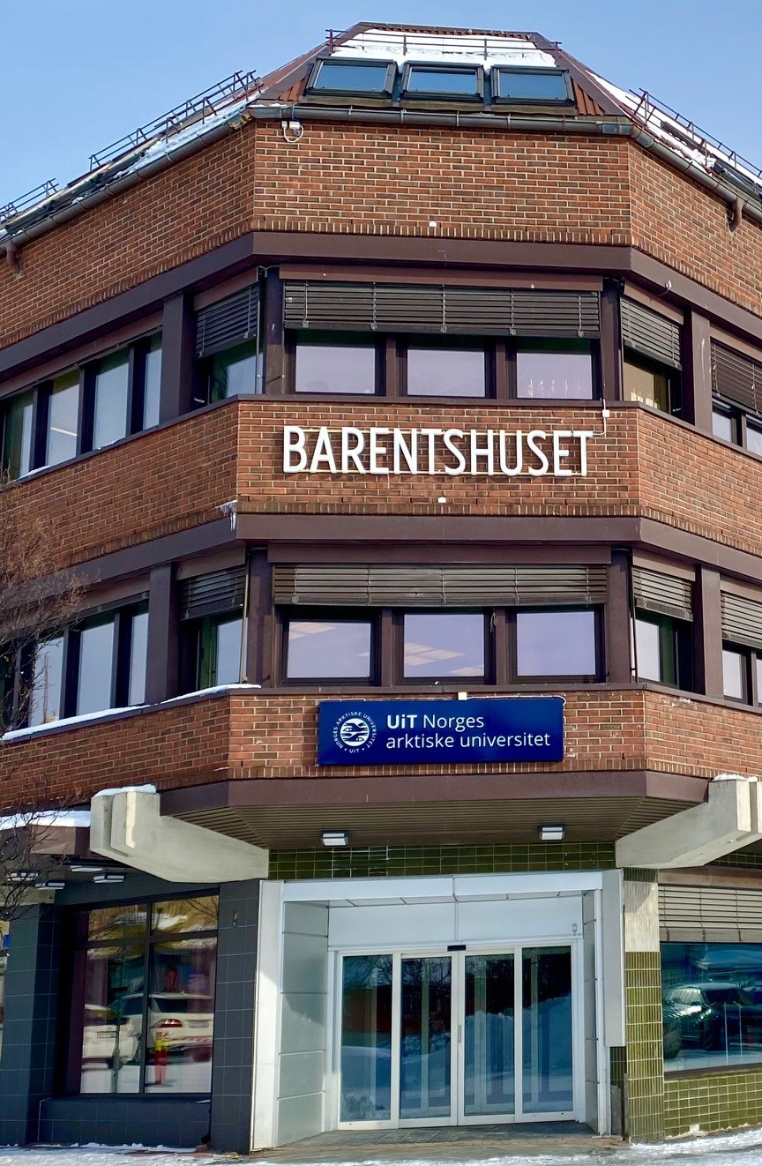
UiT campus Kirkenes
North of Norway, east of Finland
Unni Sildnes, Senior advisor
UiT in Kirkenes, Wiullsgt 3, 9900 Kirkenes
Unni.sildnes@uit.no

Slide 2
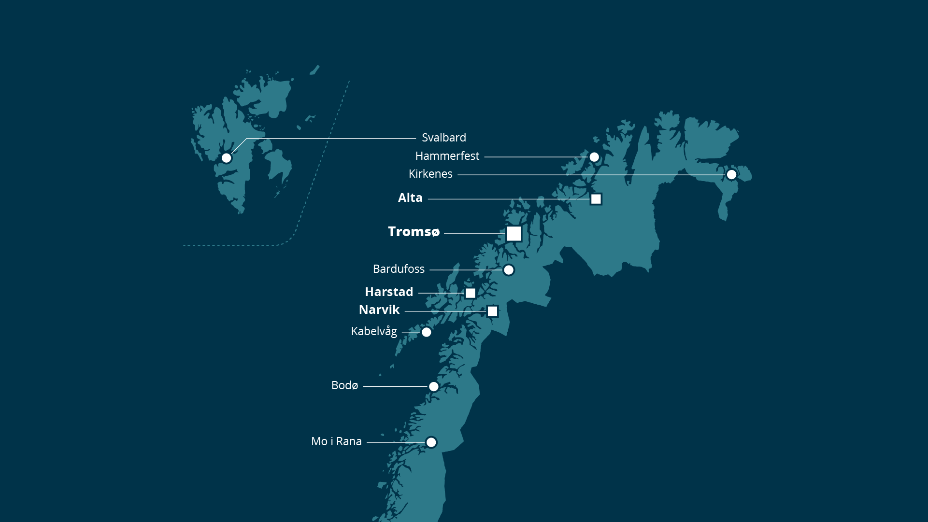
Multi-campus university, closer to the people in the North
Notes:
Flexible education
Online education

Slide 3
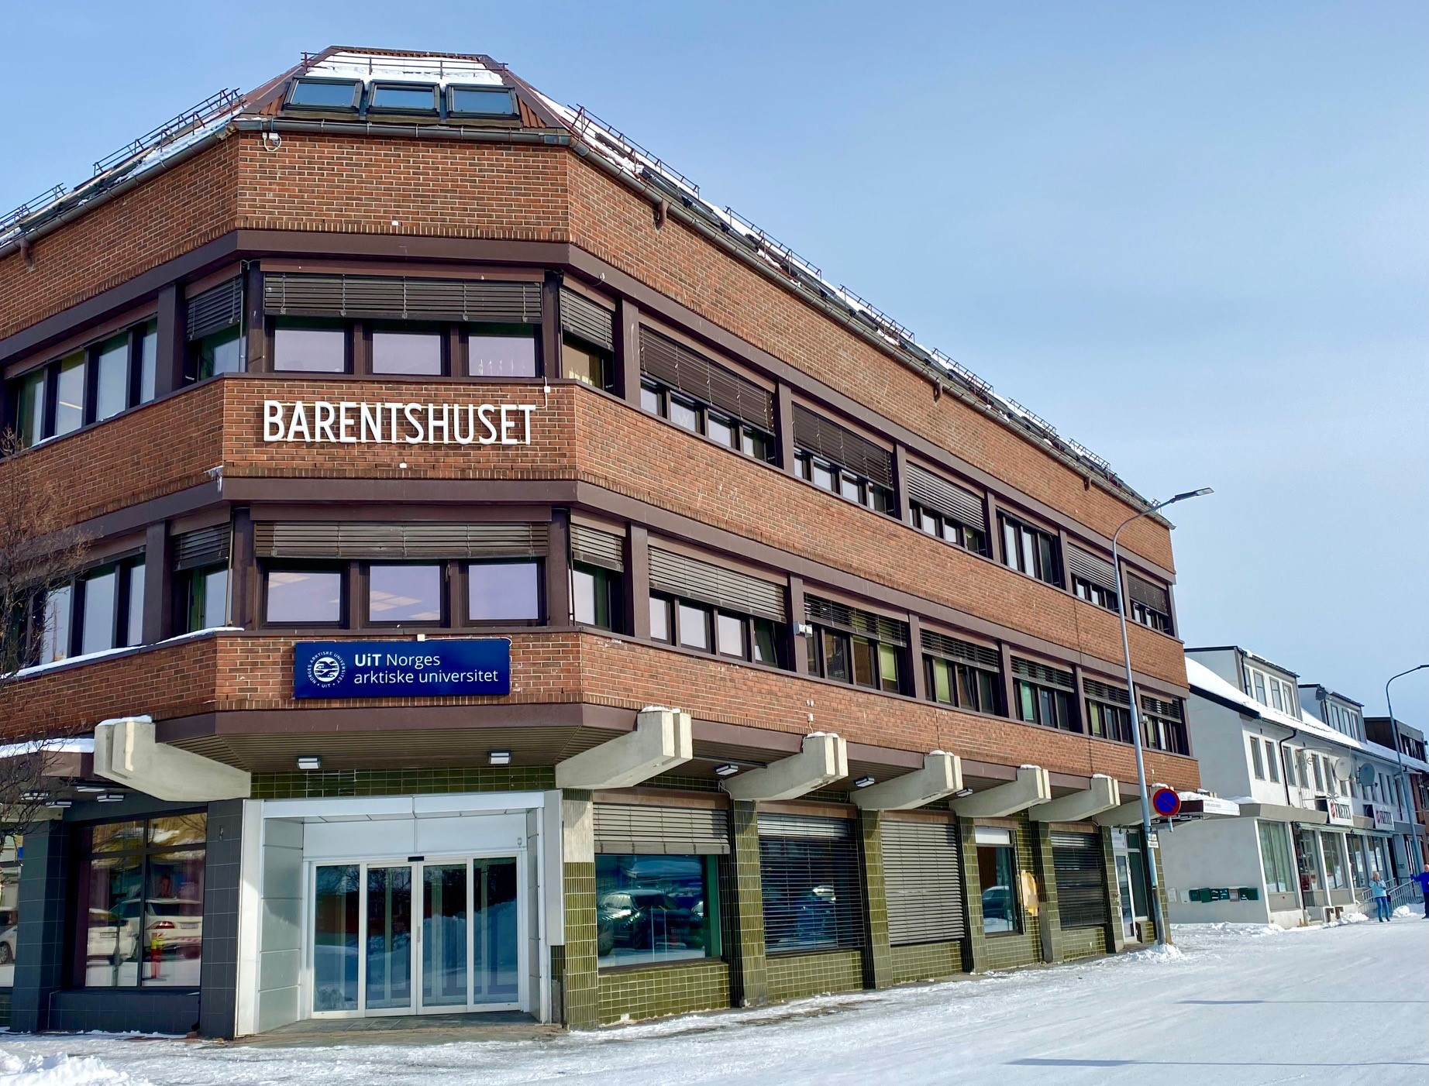
UiT in FInnmark
1 main campus, Alta
2 smaller campuses, Kirkenes and Hammerfest
6 TiKu departments
Kirkenes
  10 employees, research, education and administration
  70-120 students
Notes:
Tiku – flexible qualification programme for education and work, regional development
All of the students are flexible

Slide 4
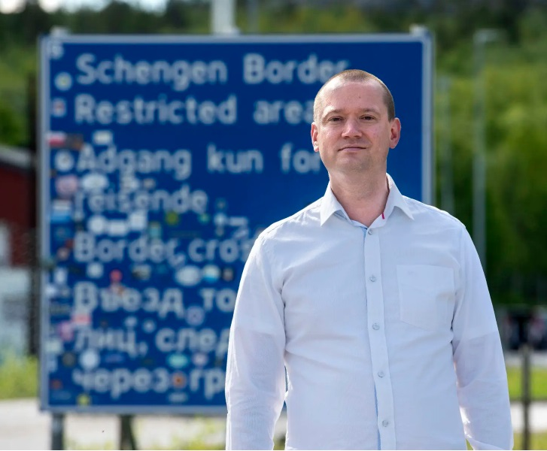
UiT Barents institute
Established 2006, UiT since 2010.
Main research focus
  Borders and border research.
  Arctic with focus on this region
  Russia.
Contribute to UiT’s focus on geopolitical studies.
Partner in organising the Kirkenes conference
Notes:
Only research institute in Norway within this niche of research
Cooperation project with barents observer, freedom of speeck ,russian exile

Slide 5
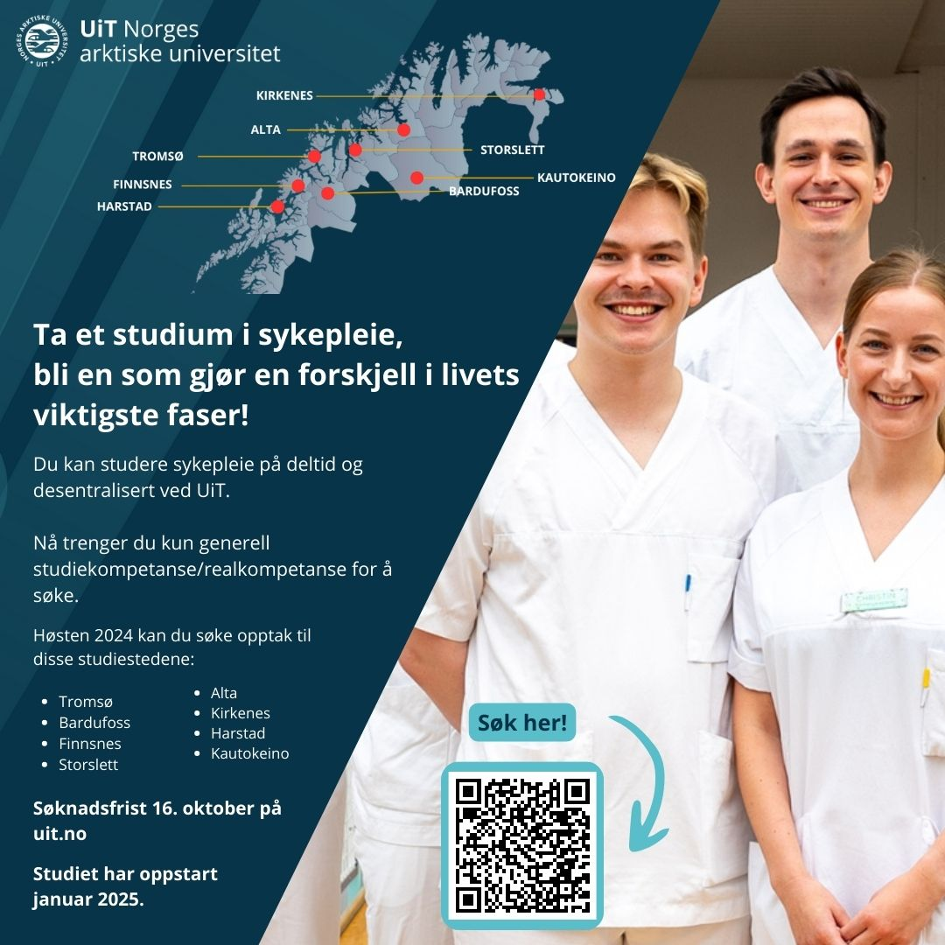
Education at UiT campus Kirkenes
Nursing and related programmes
Safety and preparedness
Tourism
Entrepreneurship
Economics and management, bachelor and master
Kindergarten teacher training
Prequalification engeneer
Online engeneer training
Online courses
Study practice arena
Cooperation with the Sami University of Applied Sciences
Notes:
Nursing, cross border in Kautokeino
Green shift , courses on demand, however little interest
Engeneer training has sustainability and the green shift included in tne education, renewable energy

Slide 6
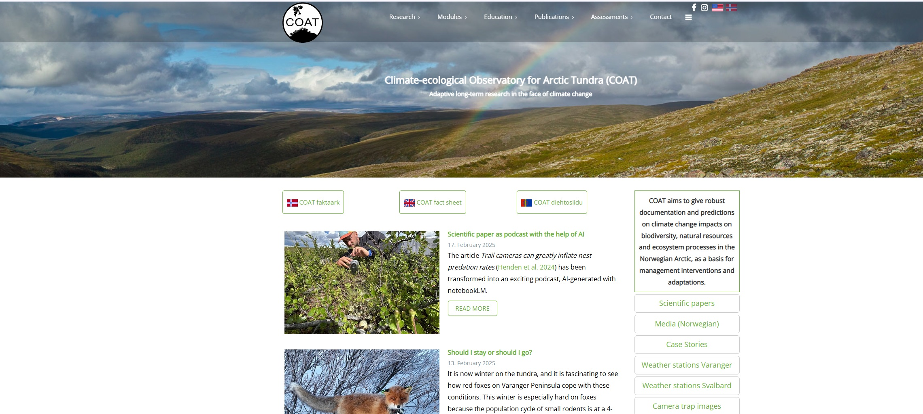
COAT,
Climate-ecological Observatory for Arctic Tundra

Slide 7
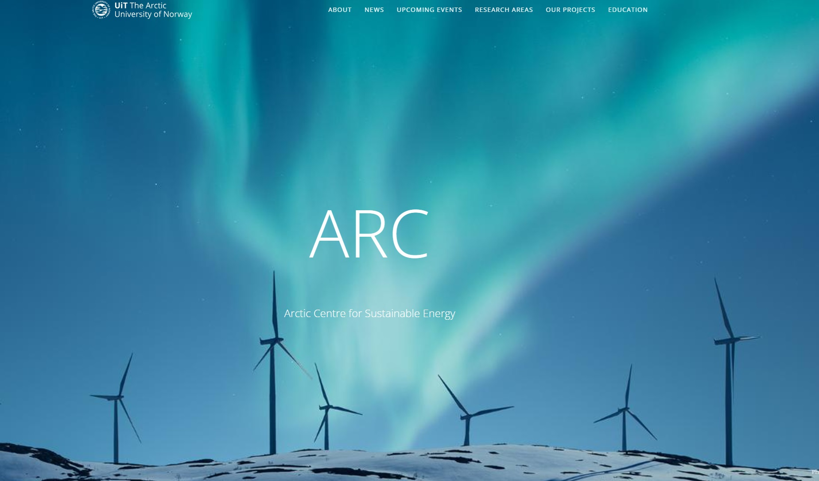
ARC,
Arctic centre for sustainable energy

Slide 8
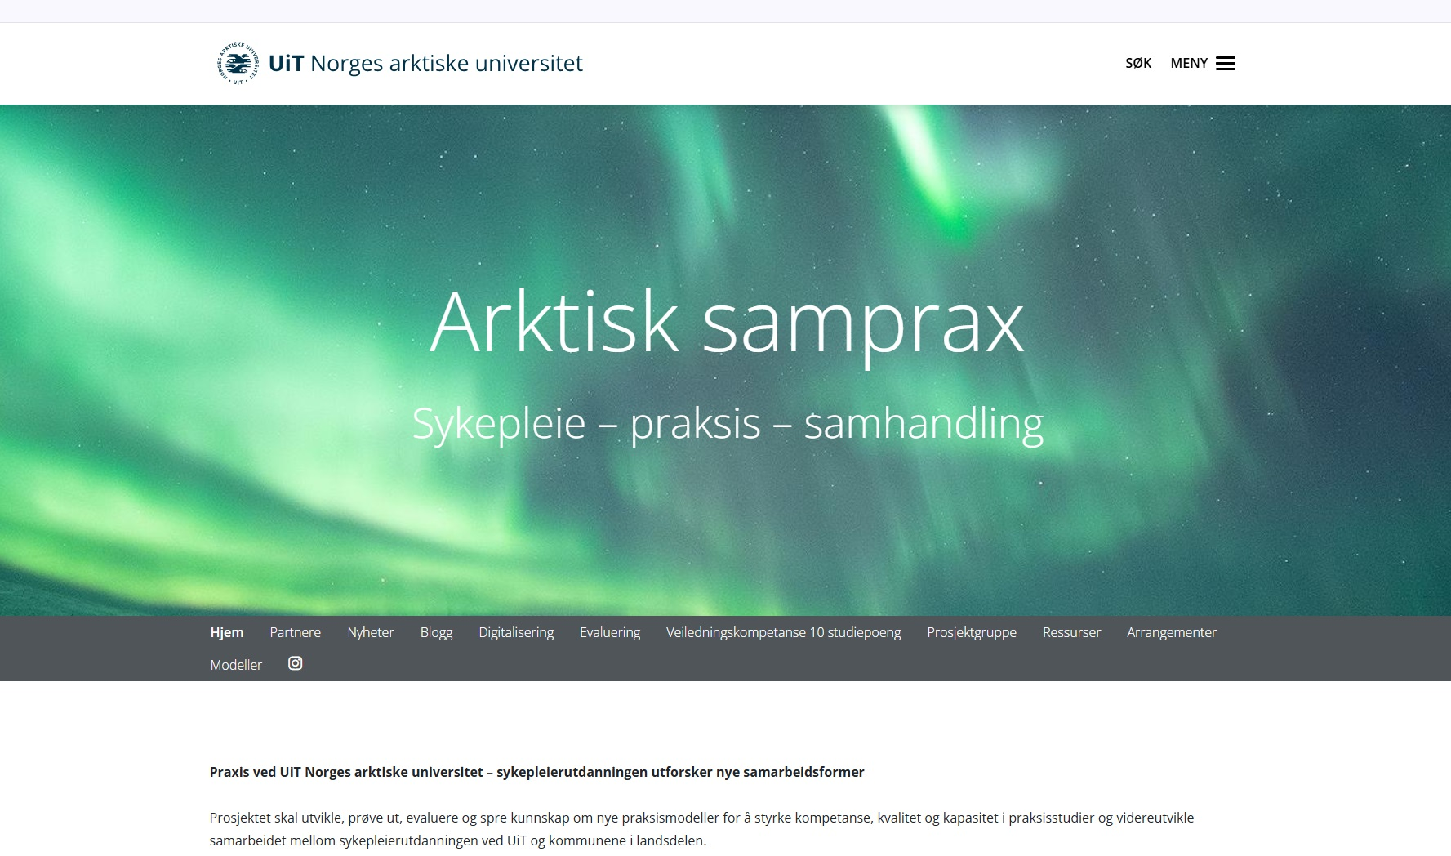
Arktisk samprax

