Slide 1



RISK-BASED MANAGEMENT
VERIFICATION METHODOLOGY
Aleš MRKELA
Managing Authority
Jems User Group
Dublin, 09.10.2024

Slide 2
LEGAL BASIS and SUPPORTING DOCUMENTS
Article 74(1)(a) and 74(2) of the CPR
Reflection Paper of the EC: RBMV 2021-2027
Guidance on the RBMV for 2021-2027 and HIT methodology

Slide 3

PREPARATION of RBMV
Workshop in Bohinj - January 2024
Representatives from three CBC programmes
External expert
Brainstorming

Slide 4

COLLECTING THE DATA for RBMV
HOW?: Excel sheet
WHO?: Joint Secretariat/National Controllers
WHEN?: Each year after the approval of the Annual Accounts
WHERE?: Jems (eMS), Self-declaration by PPs …

Slide 5

RBMV – WHO/WHICH LEVEL?
Standard projects:
partner level: National Controllers
project level: Joint Secretariat
Small-scale projects:
partner level: Joint Secretariat (HU NC for SI-HU)
project level: Joint Secretariat

Slide 6

RMBV – National controlers verification
HOW?: Automatised in Jems
WHEN? Latest till end of June 2024
WHAT? Partner reports + OTS
RISK-BASED MANAGEMENT
VERIFICATION AND CONTROL MANUAL

Slide 7
RBMV Methodology
STANDARD PROJECT
-RBMV -
based on Risk factors
SMALL-SCALE PROJECT
- RBMV -
100% check

Slide 8
RBMV Methodology
for STANDARD PROJECTS

Slide 9
RISK IDENTIFICATION
Risks | Risks description
Products and services not delivered – ineligible project | Operation not completed and/or not functional
 | Operation not compliant with initial plan (time, quantity, quality)
 | Missing evidence for indicators
2. Laws and conditions of support not respected | Wrong application of PP procedures (artificial splitting and/or non-sufficient publicity)
 | Not correctly recognised state aid
 | Unlawful changes
 | Missing documents (permits)
3. Ineligible Expenditures and non-sufficient audit trail and accounting | Indirect costs declared as direct cost
 | Wrong declaration % of staff costs
 | Double-funding, missing documents
4. Simplified cost options conditions for payment not respected | Inflated staff costs
 | Condition for support not respected: Activities, deliverables, outputs, results

Slide 10
No. | Risk criteria (RC) |  | Source of data
1 |  | Staff with working time on the project (per person) <= 15% | JS: JEMS - manually
2 |  | Number of operations run in parallel by partners (per ID/TAX number) | JS: self-declaration filled in by all PPs - manually
3 |  | Change of contractor / sub-contractor(s) | NC: JEMS - manually
4 |  | Are PP activities State aid/de-minimis relevant | JS: JEMS (check list for State aid/de-minimis) – manually
5 |  | Did the PP activities become State aid/de-minimis relevant during past year | JS: JEMS (check list for State aid/de-minimis) - manually
6 |  | Amount of financial errors detected by FLC on PP level in previous financial period 2014-2020 within the relevant programme | JS manually – Annual summary of controls background tables from eMS (history)
7 |  | Amount of financial errors detected by NC on PP level in sampled expenditures in 2021-2027 within the relevant programme | JS manually – based on previous confirmed PP reports and errors detected - background tables from JEMS
EACH RISK IS QUANTIFIED FROM -3 TO 5
SCORING
OF THE
RISKS
AT
PARTNER
LEVEL

Slide 11
No. | Risk criteria (RC) | Source of data
8 | Number of staff per PP | JEMS - automatically – count staff rows
9 | Use of the 40% staff cost flat rate | JEMS - automatically – flat rate 40% selected
10 | Planned External services related to contract > 10.000 EUR | JEMS - automatically – any expenditure in total price per row exceeds 10.000 EUR
11 | Planned amount of external expenditures of smaller (<10.000 EUR) exceeds 70% of total external expenditures | JEMS - automatically – sum of total cost in rows below 10.000 exceeds 70% of total external expenditures in category
12 | Planned Equipment related to contract > 10.000 EUR | JEMS - automatically – any expenditure in total price per row exceeds 10.000 EUR
EACH RISK IS QUANTIFIED FROM -3 TO 5
SCORING
OF THE
RISKS
AT
PARTNER
LEVEL

Slide 12
CONTENT OF THE SCORING
No. | Risk criteria (RC) | Source of data
13 | Planned Amount of equipment expenditures of smaller (<10.000 EUR) exceeds 70% of total equipment expenditures | JEMS - automatically – sum of total cost in rows below 10.000 exceeds 70% of total equipment expenditures in category
14 | Existence of investments in infrastructure | JEMS - automatically – row infrastructure and works exists
15 | Duration of the activities (in reporting periods) | JEMS - automatically – end period minus start period
16 | Underspending | JEMS - automatically – realization per partner budget till reporting minus planned partner budget till planned reporting > 0
17 | % of underspending | JEMS - automatically – realization per partner budget till reporting minus planned partner budget till planned reporting > 0
EACH RISK IS QUANTIFIED FROM -3 TO 5
SCORING
OF THE
RISKS
AT
PARTNER
LEVEL

Slide 13
Score | 0-7 | 8-20 | 21 or more
Risk | low | medium | high
LEVEL OF RISK
PARTNER
LEVEL

Slide 14
Frequency and Coverage – partner level
Level of risks on partner level/ checks | low | medium | high
Desk based: Frequency | At each report
Desk based: Coverage/Expenditures including those checked 100% (Costs) up to the L/M/H risk | min 35% of total costs declared in PP report | min 50% of total costs declared in PP report | min 75% of total costs declared in PP report
OTS: Frequency/ Number of project partners to be checked according to the level of risk | 5% | 15% | 30%
OTS: Coverage (What to check?) | In line with the OTS checklist
FREQUENCY AND COVERAGE
PARTNER
LEVEL

Slide 15
WHAT TO CHECK?
100% mandatory checks are obligatory in the cost categories:
External services (related to planned contract value above 40.000 EUR)
Equipment (related to planned contract value above 40.000 EUR)
Infrastructure and works
No checks are foreseen for the indirect costs in the cost categories:
Office and administrative costs
Preparatory costs
Travel and accommodation
Other costs

Slide 16
No. | Risk criteria (RC) | Source of data
1 | Number of operations run in parallel by partners (per ID/TAX number) | JS: self-declaration filled in by all PPs - manually
2 | Change of contractor / sub-contractor(s) | JS: JEMS - manually
3 | Are PP activities State aid/de-minimis relevant | JS: JEMS (check list for State aid/de-minimis) - manually
4 | Did the PP activities become State aid/de-minimis relevant during past year | JS: JEMS (check list for State aid/de-minimis) - manually
5 | Quality of partnership | JS: JEMS (SAG) - manually – score of assessment
6 | Quality of budget | JS: JEMS (SAG) - manually – score of assessment
EACH RISK IS QUANTIFIED FROM -3 TO 5
SCORING
OF THE
RISKS
AT
PROJECT
LEVEL

Slide 17
No. | Risk criteria (RC) | Source of data
7 | Amount of financial errors detected by JS on Project level in previous financial period 2014-2020 within the relevant programme | JS manually – Annual summary of controls background tables from eMS (history)
8 | Number of deliverables | JEMS - automatically – number of deliverable rows in project
9 | Number of staff working per project | JEMS - automatically – count staff rows per project (sum PP staff rows)
10 | Number of accepted changes (no. of application versions) | JEMS - automatically – version of application
11 | Existence of investments in infrastructure | JEMS - automatically – row infrastructure and works exists in any project partner
12 | Size of the project | JEMS - automatically – total project budget
EACH RISK IS QUANTIFIED FROM -3 TO 5
SCORING
OF THE
RISKS
AT
PROJECT
LEVEL

Slide 18
No. | Risk criteria (RC) | Source of data
13 | Number of PP | JEMS - automatically – number of PPs
14 | Duration of the project in periods - up to the programme | JEMS – automatically – number of periods
15 | Underspending | JEMS - automatically – realization per project budget till reporting minus planned project budget till planned reporting > 0
16 | % of underspending | JEMS - automatically – realization per project budget till reporting minus planned project budget till planned reporting > 0
EACH RISK IS QUANTIFIED FROM -3 TO 5
SCORING
OF THE
RISKS
AT
PROJECT
LEVEL

Slide 19
Score | 0-10 | 11-28 | 29 or more
Risk | low | medium | high
LEVEL OF RISK
PROJECT
LEVEL

Slide 20
Frequency and Coverage – project level
Level of risks on project level/ checks | low | medium | high
Desk based: Frequency / Project reports to be checked according to the L/M/H risk (risks shall be defined for all projects consisting of a pool of projects in risk group) | Based on submission: Every 5th project report submitted from the pool of low-risk projects | Based on submission: Every 3rd project report submitted from the pool of medium-risk projects | Based on submission: Every 2nd project report submitted from the pool of high-risk projects
Desk based: Coverage (What to check?) | In line with the JS checklist
SSV: Frequency/ Percentage of projects to be checked according to the level of risk from the pool of projects in risk group | Defined once a year after RBMV exercise 10% | Defined once a year after RBMV exercise 25% | Defined once a year after RBMV exercise 50%
SSV: Coverage (What to check?) | In line with the SSV checklist
FREQUENCY AND COVERAGE
PROJECT
LEVEL

Slide 21
RBMV Methodology
for SMALL - SCALE PROJECTS

Slide 22
Frequency and Coverage – project level
Desk based: Frequency / Project reports to be checked: all projects from a pool of projects have the same risk factor the pool of projects is consisting of all contracted projects from each SSP submission deadline | Automatically - randomly chosen 80 % of all projects.
Desk based: Coverage (What to check?) | In line with the JS checklist for SSP
SSV*: Frequency/ Projects to be checked: all projects from a pool of projects have the same risk factor the pool of projects is consisting of all contracted projects from each SSP submission deadline | Automatically - all projects that were not desk-based checked (20%).
SSV: Coverage (What to check?) | In line with the SSV checklist for SPP
FREQUENCY AND COVERAGE
PROJECT
LEVEL

Slide 23
FROM THEORY TO PRACTICE

Slide 24
CONSIDERATIONS
Where shall the data be stored – JEMS or any other system
Where do we take data from – JEMS, manually, Keep, Arachne, other
Which programming language to use – is there a framework
What personnel do we have for implementation – internal/external
How flexible we can be
Do we touch the Core JEMS
Timing and cost of implementation
What we have and can we build on top of that
…

Slide 25
CONCRETE ANSWERS
We implemented some plugins in JEMS that are pretty standard
We did some Exports in JEMS, but only for paper visualization
We did produce an Aggregator tool that uses API for data
We already take data from JEMS and put it in aggregator database
We added models in own database for usage of data
We have dedicated servers for own implementations
We don‘t know what additional functions can we expect in JEMS
Aggregator app gives us more flexibility as we know development timeline

Slide 26
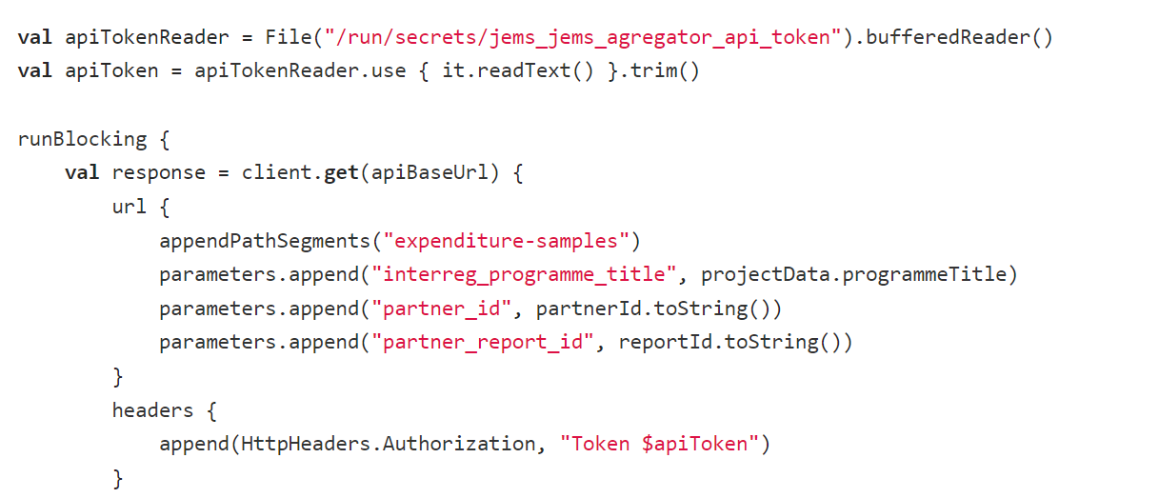
DECISION
Create as much as possible in Aggregator (fast, secure, easy framework)
Query Aggregator via API
Take data from JEMS and turn it around in Aggregator application (presentation layer)
Modify plugins so that they interface with Aggregator app

Slide 27
PROCESS WORKFLOW OF RBMV
We added items that are not present in JEMS to Aggregator (risks, scores, different programmes, unique identifiers…)
When report starts to be checked plugin in JEMS asks Aggregator API for selection of invoices
Aggregator asks JEMS to send him all the updated data and selects items for the verification based on presented methodology
Aggregator sends to JEMS data to be selected
JEMS plugin selects data in JEMS database so the controller can see them properly
Similar process is implemented also at the level of Project reports with a contentwise difference – sampled item doesn‘t have to be checked

Slide 28




