Slide 1

Oummu rââst raaj -
People cross the borders
Sep 2024 - Aug 2026
Interreg Programme. Exchange visit
26th of February 2025, Barentshuset, Kirkenes

Slide 2
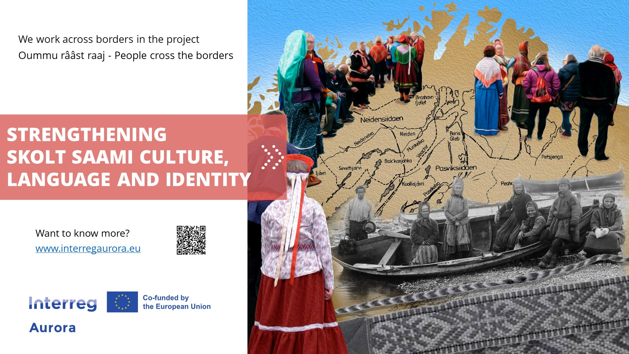

Slide 3
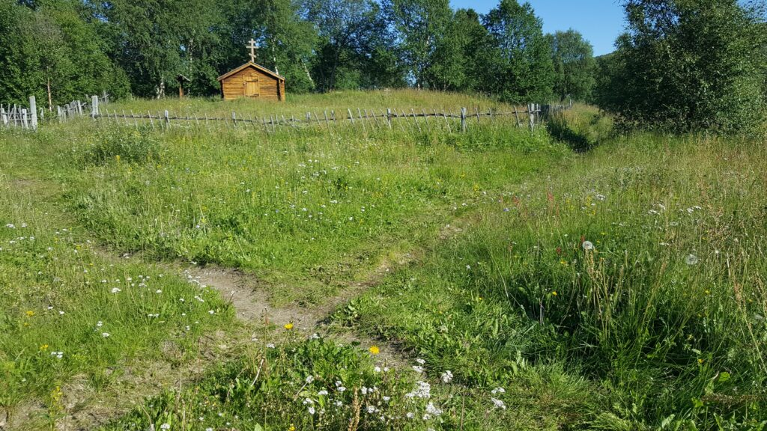
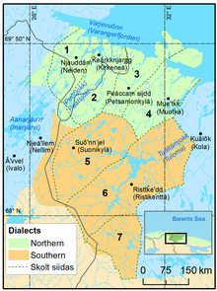
Who are Skolt Saami?
Sámi ethnic group
Live in Inari municipality (Finland), Sør-Varanger municipality (Norway) and the Murmansk Region (Russia)
1826 – state borders demarcation
Orthodox
Traditional territories of Skolt Saami

Slide 4
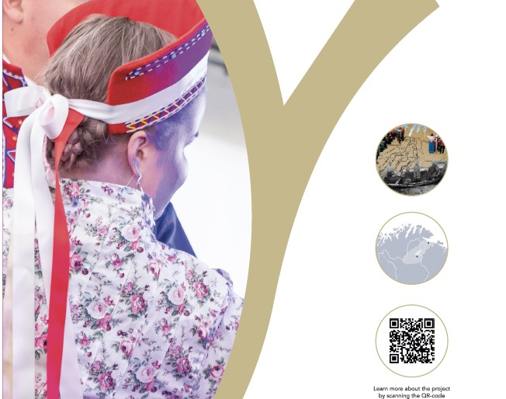
Strengthening
Skolt Saami
culture,
language and identity

Slide 5
Project partners
NORWAY
Lead partner: Sør-Varanger Municipality
Ä'vv Skolt Saami Museum, Neiden
Tana and Varanger Museum Siida
Norrõs Skolt Saami Association
Sámi Parliament in Norway
Pikene på Broen
Sør-Varanger Culture School
Pasvik Folkhøgskole
NIBIO Svanhovd
UiT The Arctic University of Norway
FINLAND
Lead partner: Inari Municipality
Skolt Saami Siida Administration
Skolt Saami Cultural Foundation
Sámi Parliament in Finland
Sámi Education Institute, Inari
University of Oulu, Giellagas Institute for Sámi Studies

Slide 6
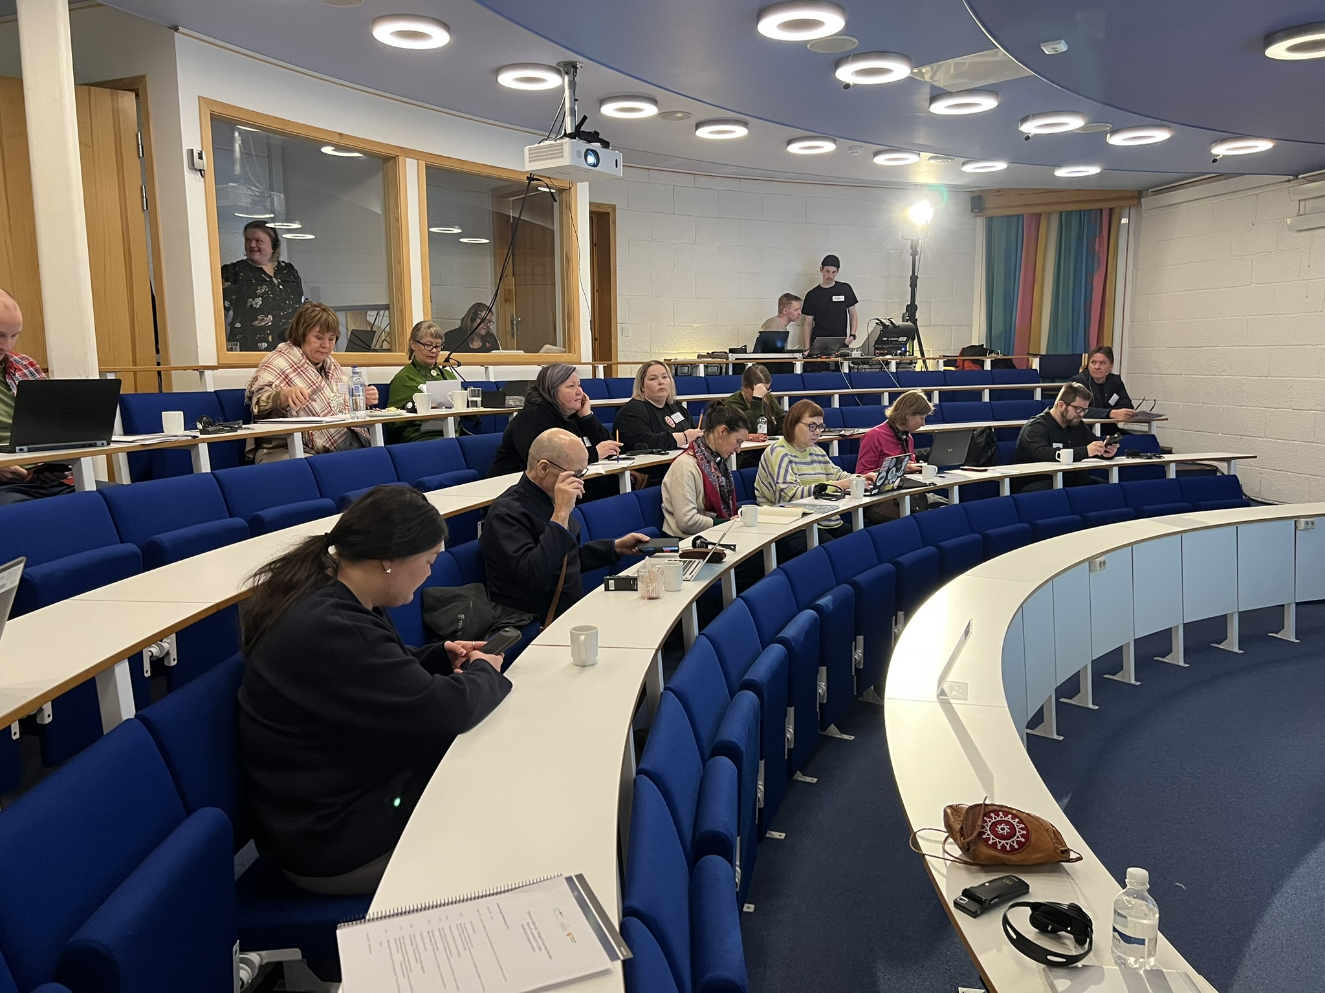
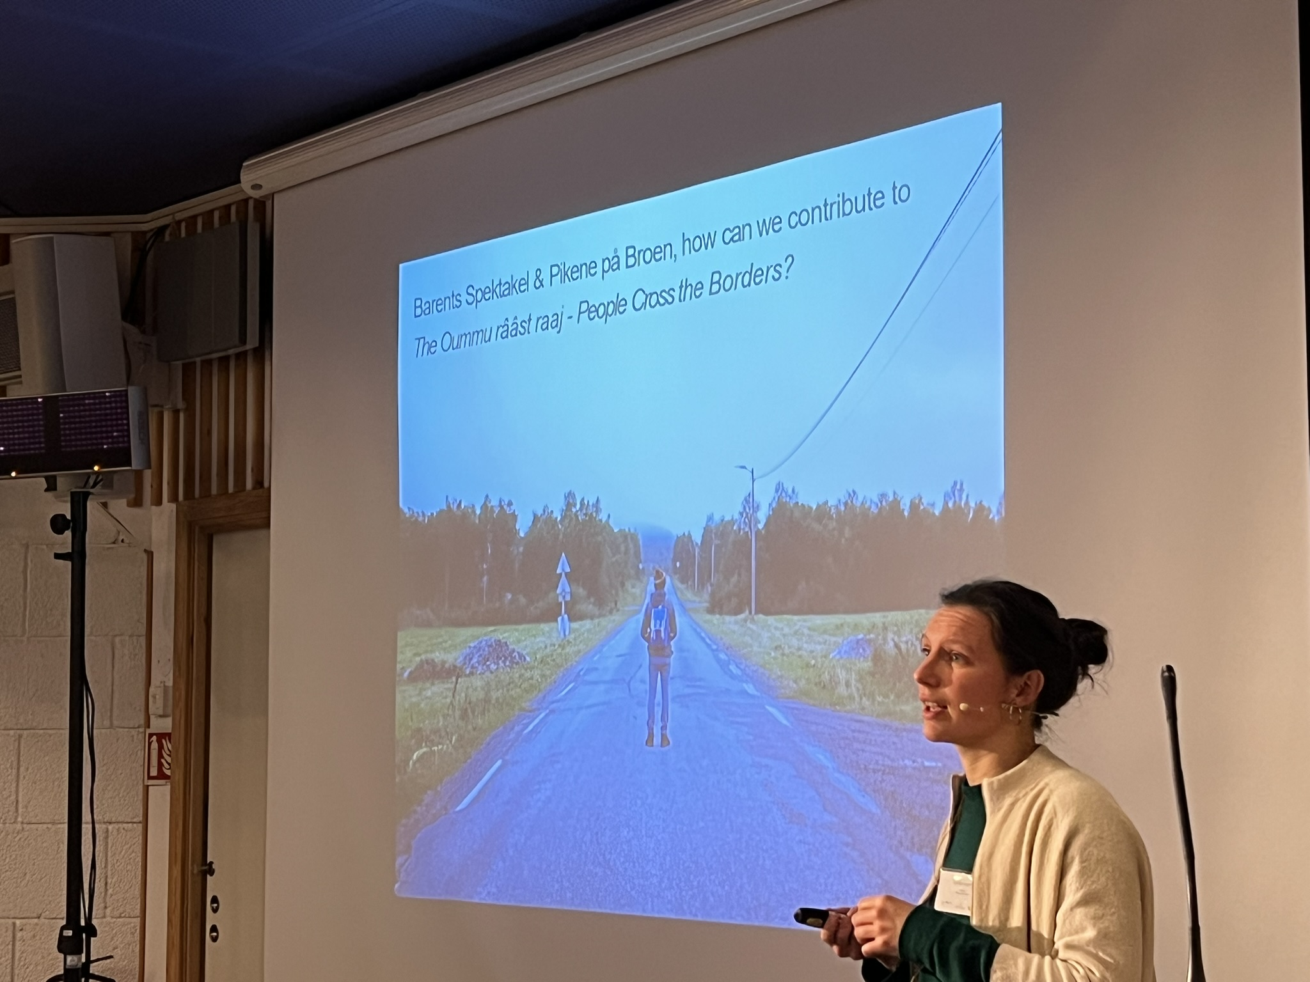
Work package 1: Networking. Cooperation and knowledge exchange

Slide 7

Work package 2: Skolt Saami Language
Nuõrttsäämkiõll – in UNESCO endangered languages list
Norway (2021): about 400 Skolt Saami and 10-12 speakers
Finland: 600-700 and about 300 speakers
Pilot course for Sør-Varanger

Slide 8

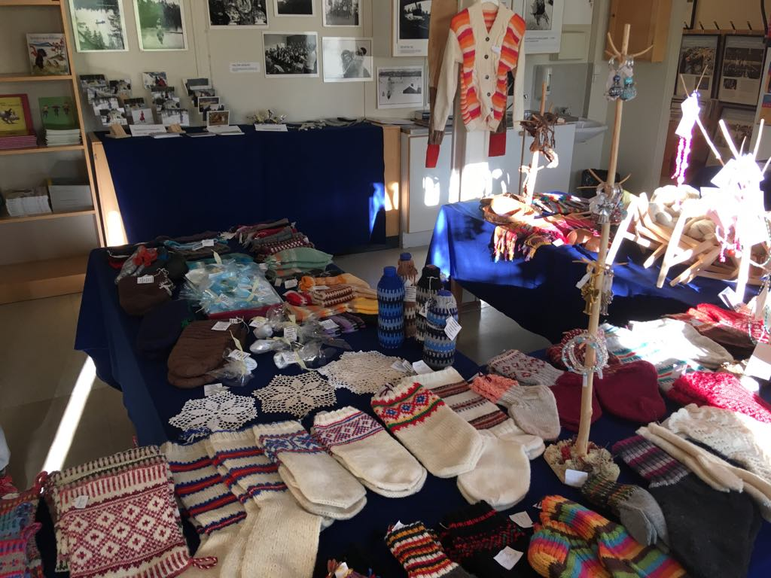
Work package 3: Skolt Saami Culture
Cultural and language Café
On a regular basis starting today at the library, Ä’vv museum etc.
Discussions in a cosy and safe environment
Photo: MON LEÄM SÄ’MMLAZ

Slide 9
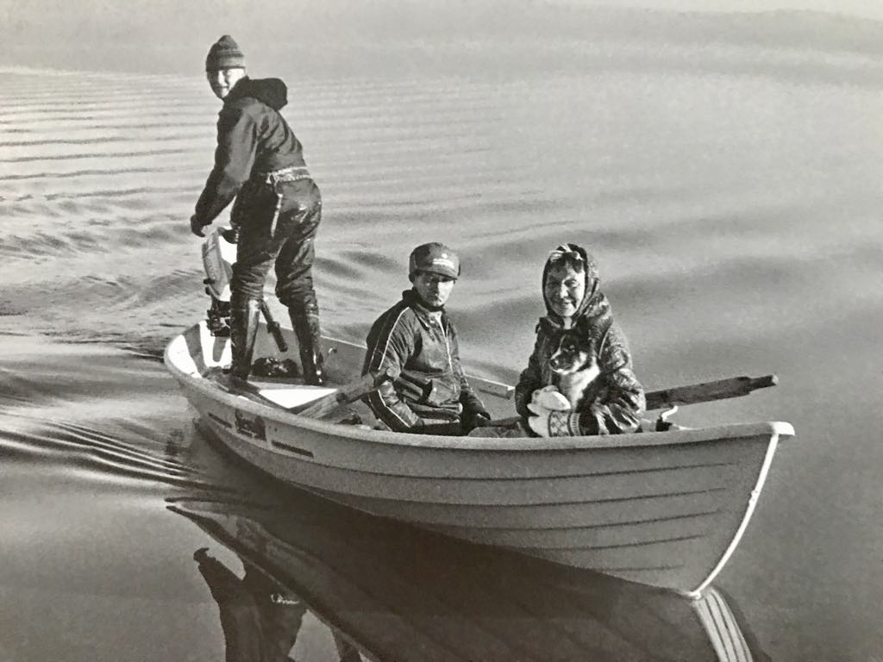
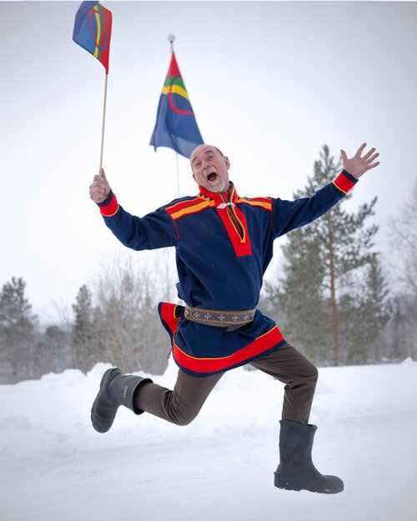
Work package 3: Skolt Saami Culture
Two summer and one winter camps to explore Skolt Saami traditions
Summer camp No.1:
Pasvik, July 2025
Joint hikes in the areas of traditional settlements
Photo: Pasvik Folhøgskole

Slide 10
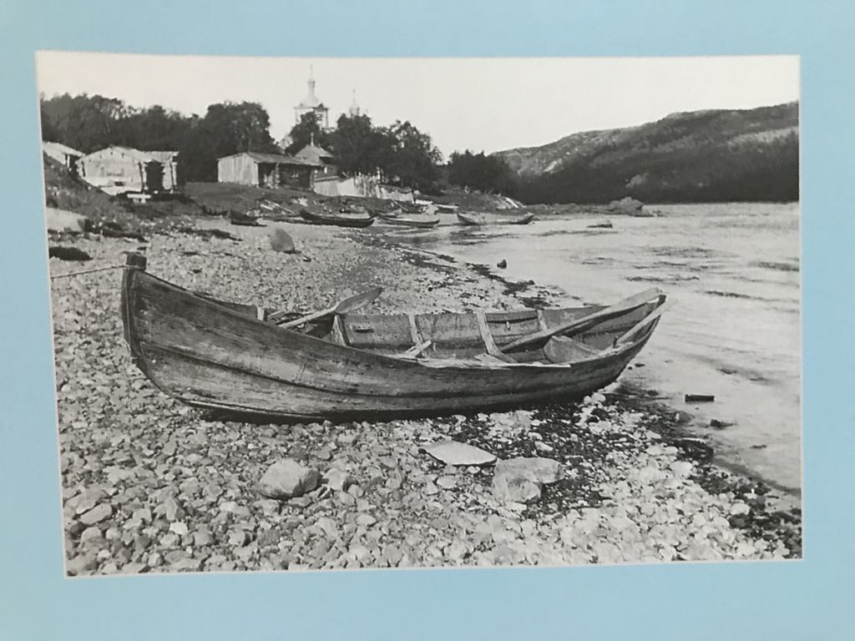
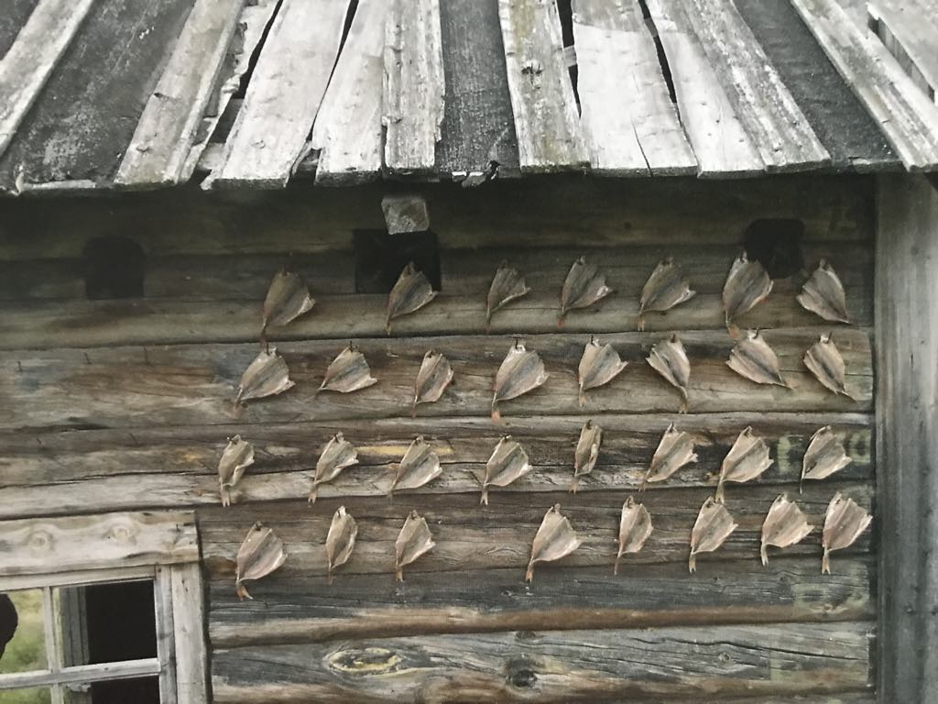
Work package 3: Skolt Saami Culture
Lectures on Skolt Saami history in the library and Ä’vv museum
Genealogy course: information support
Seminar on history, cultural heritage and psychological support: September 2025, Kirkenes

Slide 11
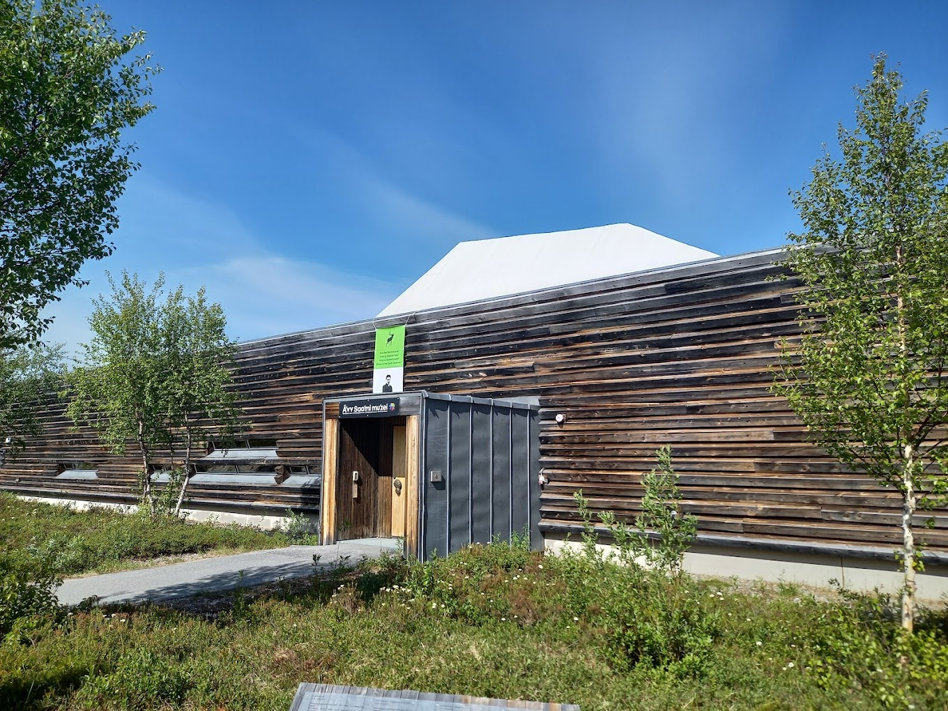
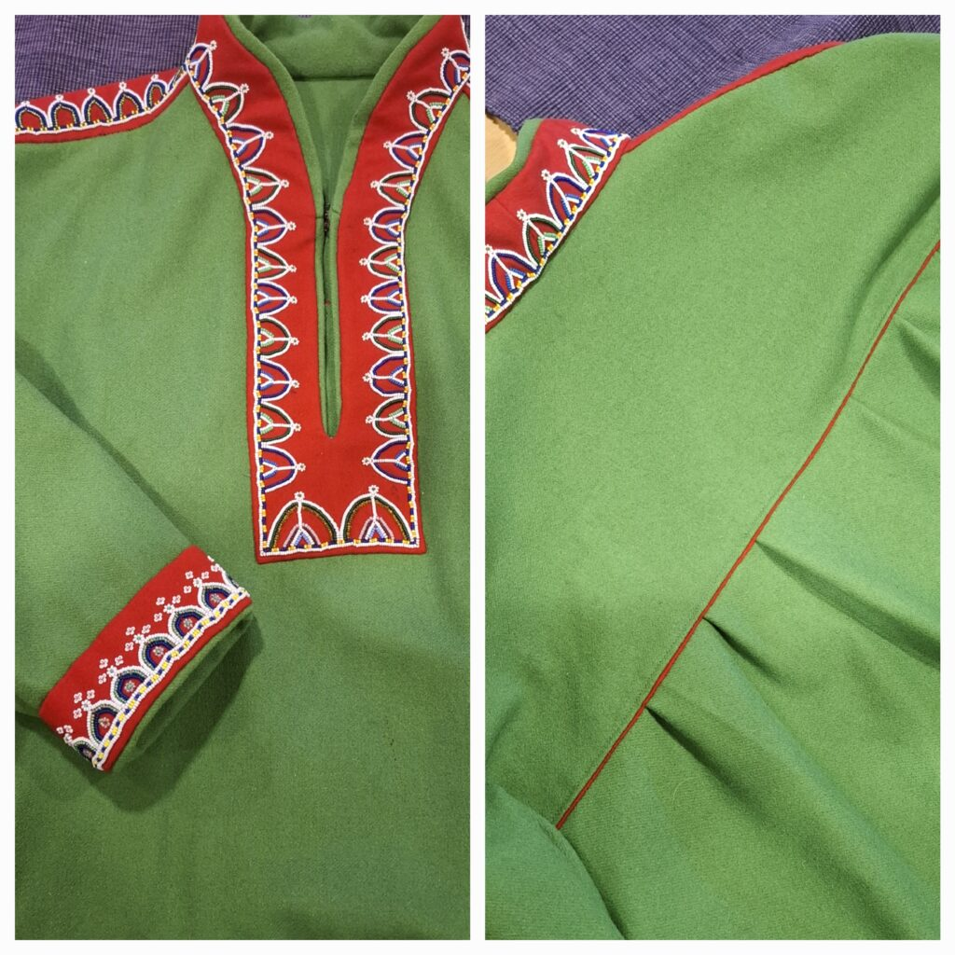
Work package 3: Skolt Saami Culture
Skolt Saami films at GIISÁǨEÄISS festival in Sør-Varanger: 8-16 March 2025
Family day at Ä`vv museum, Saturday 8 (15) March
More festivals
Follow is on Facebook for more info!

Slide 12
Thank you! Spä’sseb!
Mari Gauriloff
Project Manager, Inari municipality
Mari.Gauriloff@inari.fi
Joni Gauriloff
Project worker, Inari municipality
Joni.Gauriloff@inari.fi
Maria Dianova
Project leader, Sør-Varanger municipality
Mdian@svk.no
Follow us on Faceboook!
https://www.facebook.com/profile.php?id=61572079001822

