Slide 1
KOSTRA – Norwegian Local Government State Reporting Opens possibilities for good governance and gives citizens opportunities for insights into municipal priorities
Sigmund Engdal, special finance advisor, 31st of May 2022
«An independent and innovative municipal sector»

Slide 2
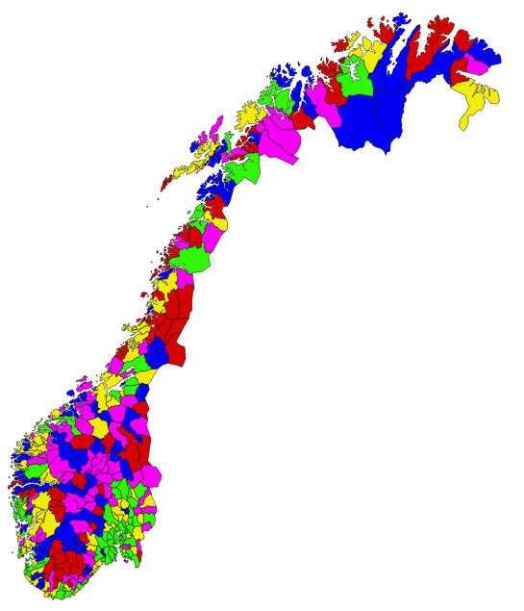
356 municipalities and 11 counties in Norway
Generalist principle, all municipalities have equal responsibilities by law
provides a framework for municipal funding
Number of inhabitants 1.1.2021
Municipalities
18 290 – 697 010 71
6 958 – 17 851 71
3 587 – 6 956 71
1 959 – 3 464 71
192 – 1 920 72

Slide 3
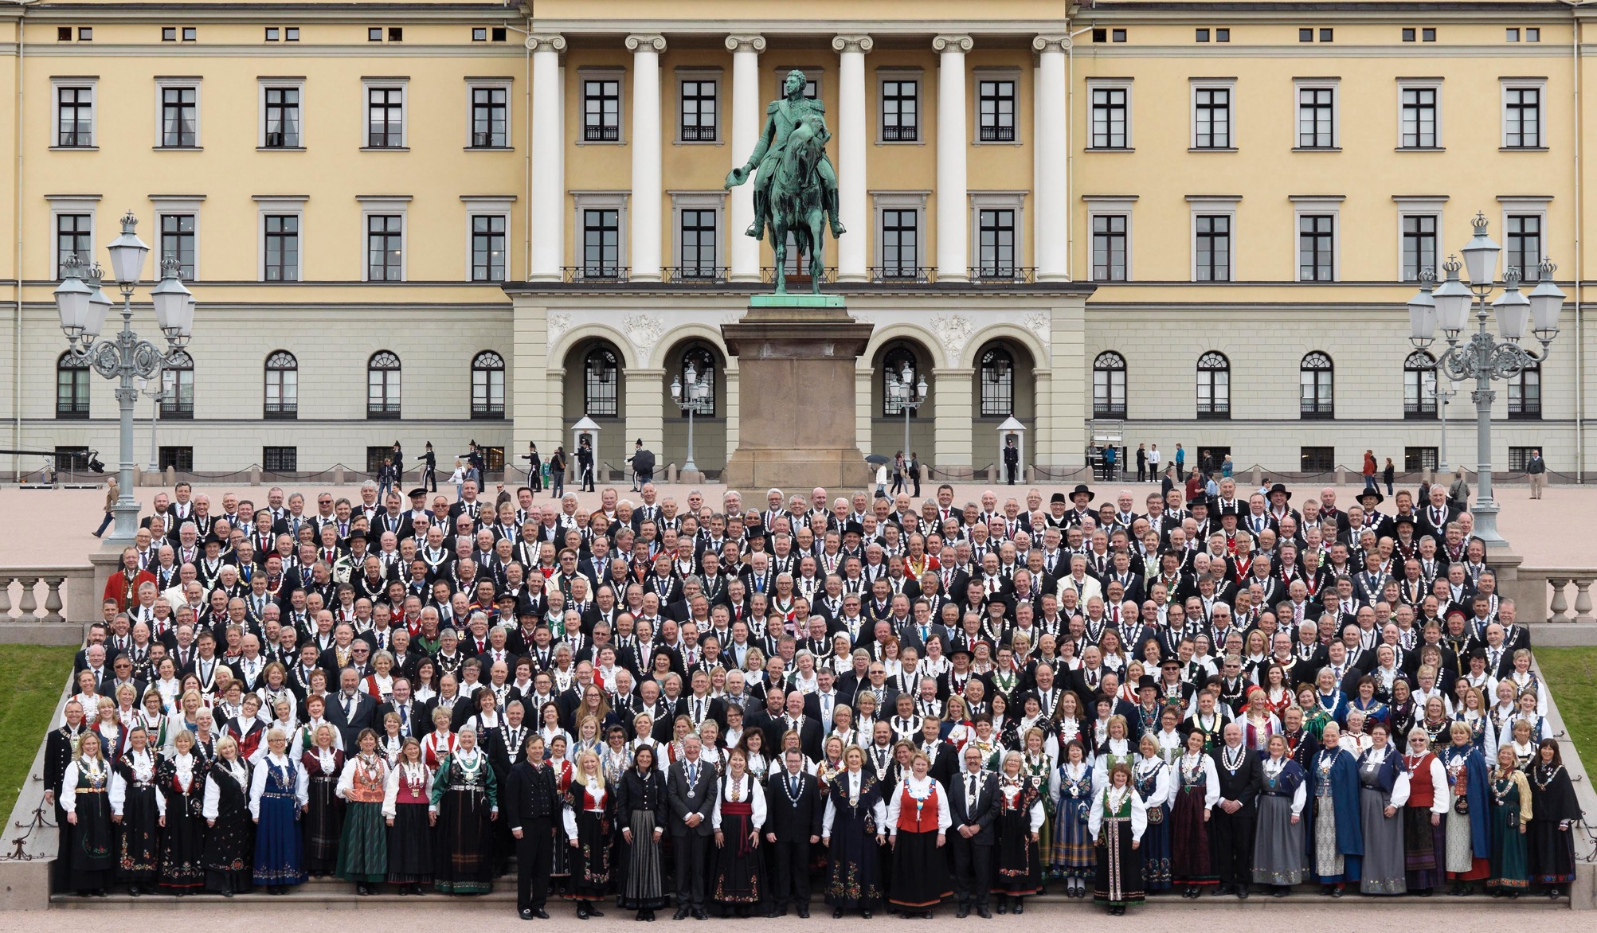
What is KS
Notes:
All Norwegian municipalities and county councils are members of KS. From 2020: 11 counties and 356 municipalities. There is a huge workforce in the local government sector – almost half a million employees and more than 11,000 committed local politicians.
Norwegian municipalities exist in a challenging intersection between local autonomy and national legislation and regulations, with a financial framework determined by the Storting. A good dialogue between the state and the local government sector is highly important.
A scene from the Constitution Jubilee in 2014, where all the country’s mayors were invited to Oslo for a ceremony at the Castle. Photo: Oslo kommune/Fotograf Sturlason

Slide 4
National congress
County boards
National Council
County conferences
Executive Board
ADVISORY BODY
Committee of chief executives
County committees of chief executives
Local councils and county councils
Notes:
All municipalities and county councils in the country are members of KS. Duly publicly elected members of local and county councils may be elected to the boards of KS. Union officials from the entire country are represented on the county boards, the National Board and the Central Board. The National Congress is the highest controlling organ of KS and meets every fourth year after the local elections. The next assembly of the National Congress will be held in 2024.
Organisation
County conferences All members are represented at the county conferences. After each election to the local councils and county councils, the county conferences elect delegates to the National Congress, and from these the members and chairman of the county board are elected. The annual county conferences discuss and anchor the work of KS with the government, and also wage negotiations, binding agreements and other important and principal matters. The county conferences may also take up local or regional matters that can provide guidance for the work of the county boards.
The county boards Nobody knows the local communities and the regional political scene better than the representatives on the county boards. They support KS by organising and taking charge of ongoing political activities at county level and are KS' most important nodal points for contact with members.
The county boards ensure that KS has the necessary political support, and put forward suggestions and recommendations which they consider will support the municipal sector’s points of view in dealings with the state and in public debate. Both in preparation for central wage settlements and in political questions, it has proved very importantly that through discussions have been held at county level, and that clear feedback is given to KS. The county board members are automatically appointed to the National Council. KS' regional offices are secretariats for the county boards.
The National Congress The National Congress is the highest authority in KS. The National Congress determines the overall political framework that KS must follow for the next four years and elects the Executive Board of the organisation and its political leader. The National Congress consists of approximately 240 elected delegates local councils, county councils and enterprises. (The articles of association will be reviewed in 2020.) The delegates who were appointed at the county conferences elect the representatives to the National Council and the Executive Board. The leaders of the Executive Board are also elected.
The National Council The National Council is the highest authority in KS between assemblies of the National Congress. The National Council meets at least twice a year and consists of all the leaders of the county boards, the whole of the Executive Board and 18 representatives elected by the National Congress. This is the highest organ in KS in the four-year periods between assemblies of the National Congress. The National Council sets the direction, and among other things decides on the long-term plans for KS. In addition, the National Council deals with questions about what KS requires from the state in connection with its regular meetings with the government.
The Executive Board The Executive Board takes charge of the daily political management of KS and implements the decisions of the National Congress and the National Council. The Executive Board lays the budget for KS centrally and in the counties. The Executive Board normally meets ten times a year, and otherwise as required, for instance during wage negotiations. The Executive Board appoints representatives to international organisations of which KS is a member. The Chairman of KS is Gunn Marit Helgesen (Conservative). The first deputy-chairman is Sven Tore Løkslid (Labour) and the second deputy chairman is Jenny Følling (Centre).
The Executive Board has 15 members, one of whom is elected by Bedriftsstyret (the enterprise board).
Committee of chief executives
KS has its own committee for chief executives (chief municipal executives). It is a consultative organ and is elected at the national meeting of chief executives (the national meeting of chief municipal executives). There are also chief executive committees at county level. In the regions, KS serves as the secretariat for the county chief executive committees. In addition to the county boards, they are good supporting agents and consultants for KS. The national meeting of chief municipal executives, which is held every two years, appoints representatives to the central Committee of chief executives. The chairman of the committee attends meetings of the Executive Board as an observer with the right to speak and propose motions.

Slide 5
KS’ roles
Advocacy group
KS
Employer organisation
Development partner
Notes:
KS engages in evidence based advocacy.
KS is the largest employer organisation in the public sector.
KS is intended as a development partner for the municipal sector.
KS is not:
a supervisory authority to ensure that the municipal sector follows legislation and orders
a directorate that gives its members instructions
a development partner for the state to impose conformity on the municipalities

Slide 6
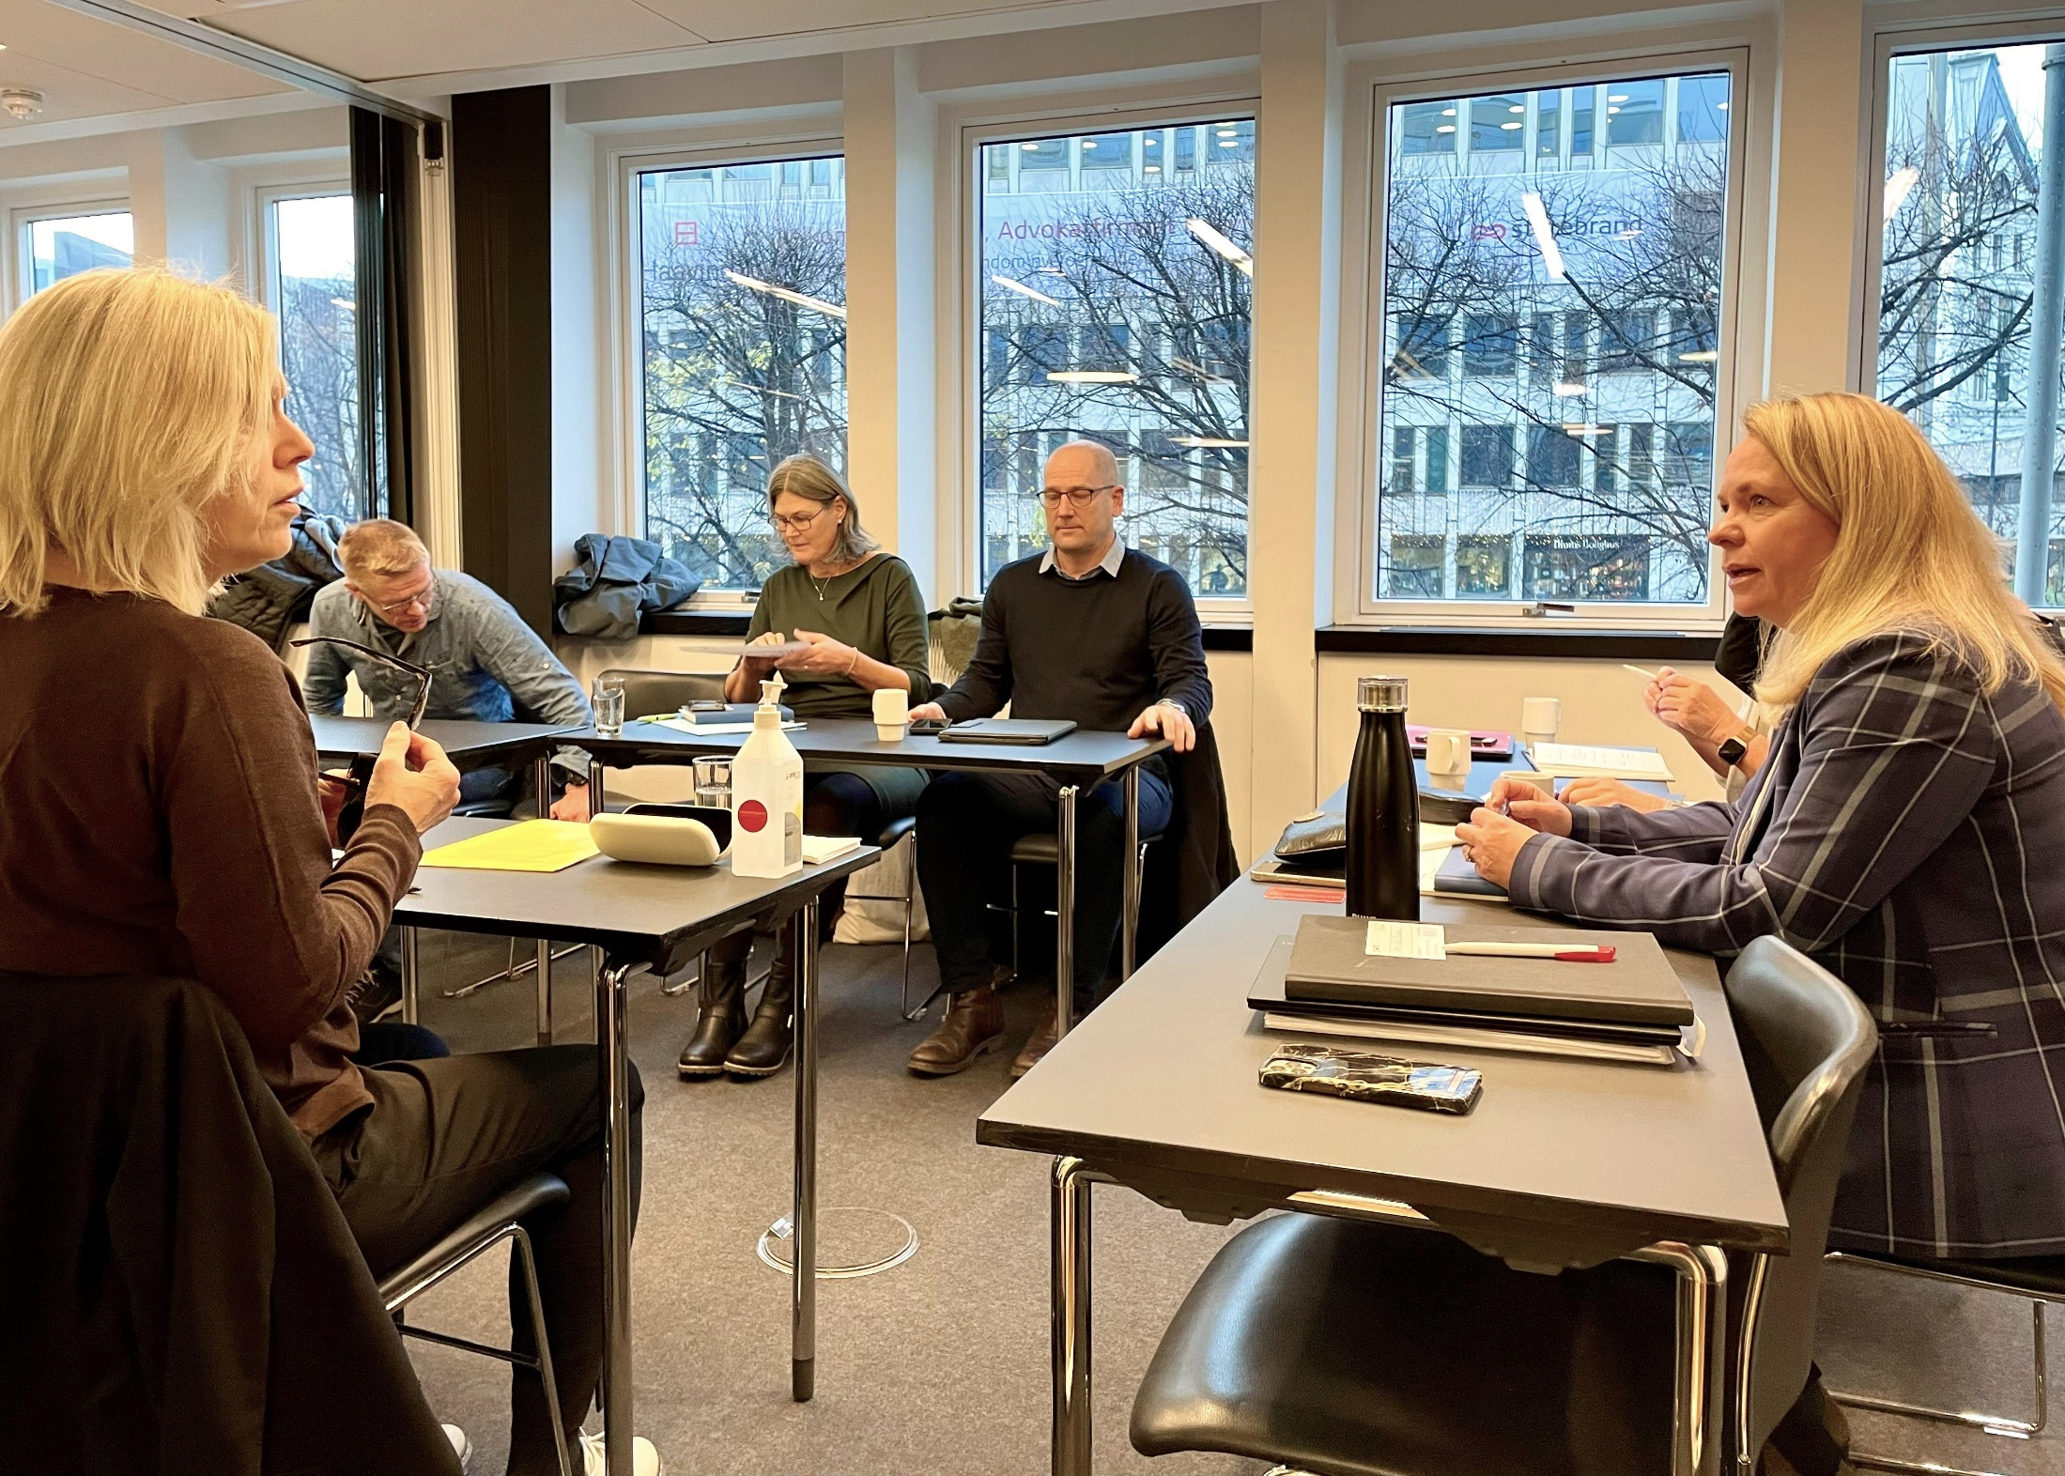
KS AS AN EMPLOYER ORGANISATION
Negotiating and bargaining party
KS is the largest employer organisation in the public sector
Authorised to enter into and terminate key collective agreements
In 2021 KS negotiated the settlements for around 450,000 local government employees to a value of NOK 299 billion
Negotiating working-hours agreement for teachers, fall of 2022.
Photo: KS
Notes:
Negotiating and bargaining party
Authority on behalf of all municipalities and county councils (except Oslo) to enter into and terminate key collective agreements. KS negotiates with four negotiating bodies: LO kommune, Unio kommune, YS kommune and Akademikerne kommune, which represent 41 trade unions and 100 professional groups.
This authority is secured through good political processes among the members and is adopted by the Executive Board.
It works for a wage policy which:
allows scope for local priorities
stimulates renewal and even better services to the public
attracts qualified manpower
KS enters into collective agreements, among other things on:
Wages
Terms of employment
Pensions
Participation in decision-making
Consulting on legislation and agreements.
The IA agreement
Policy on qualifications
Working hours
Good management guide
Steps to reduce absence due to illness
Full-time work

Slide 7
KS as a development partner to the local government sector
KS’ development programme reflects the challenges faced by its members.
Good outcomes are achieved for key initiatives by working together.
Notes:
The municipal sector is regularly faced with complex challenges for which there are no clear answers. Some of these challenges are linked to general developments and trends in society, while others are more specific to the municipal sector. Demographic changes, increased digitisation, changes in residents’ expectations, and a possible restructuring of the sector are some of the most important challenges.
Large sections of development activities are organised as networks and meeting places where members facing similar challenges share experience and knowledge. The networks are administered through KS centrally or in the regions.
KS provides a secretariat for various collegial groups of both political and administrative managers. For instance, KS coordinates the municipal sector’s ethics committees. These environments are often consulted for advice or to test ideas in development work.
The municipal sector is strongly influenced by issues that arise from EU and EEA policies. The KS office in Brussels offers several services and has extensive expertise in these areas. The office is responsible for much of the collaboration with European sister organisations and other member organisations internationally.

Slide 8
Consultations
KS’ EVIDENCE BASED ADVOCACY WORK
Ongoing dialogue with the government
Legislative consultation
Technical Reporting Committee on Local Government Finances (TBU)
Agreements
Government ministries
Participation in Official Norwegian Reports
Hearings
The directorates
Co-ordination of government inspection regime
Professional dialogue
Notes:
Holds regular consultative meetings with the government
Consultative meetings with the government:
Professional and political dialogue
First meeting: Before the government budget conference in March. Macro-framework for the municipal economy next year
Second meeting: Before the Revised National Budget (RNB) and municipal Bill in May. Major individual cases
Third round of meetings: in the autumn with each ministry individually. More detailed matters. For example in areas such as municipal finance, wage development, climate improvements, working environments, youth and care services.

Slide 9
Hearings
KS’ EVIDENCE BASED ADVOCACY WORK
Meeting with the committees on legislative issues and white papers
Meeting with party groups and regional MPs
The county boards meet regional MPs
Joint meetings on relevant issues
Contact with individual MPs
Professional and political dialogue

Slide 10
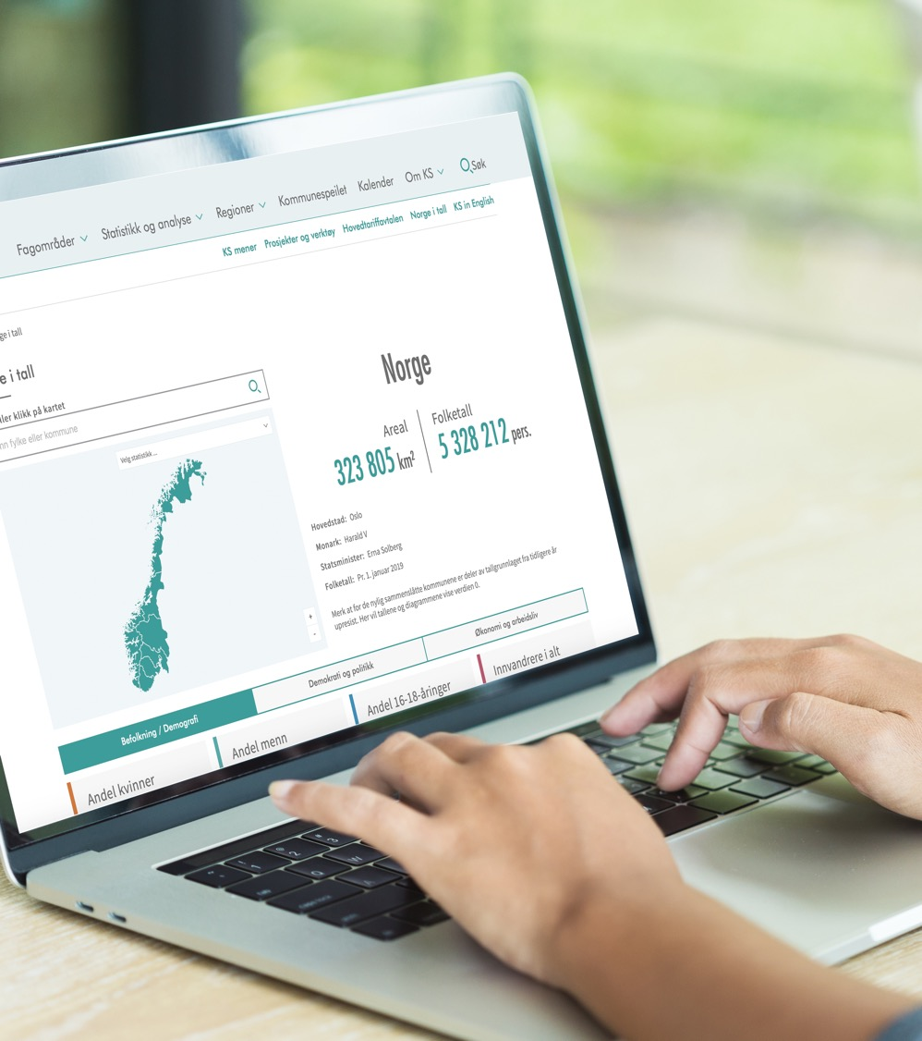
KS builds knowledge
KS research and development
Statistics and analysis
ASSS
Publication “Status Kommune”
Norway in figures --------------------
PAI register
Employer monitor
Notes:
The R&D scheme is intended to provide expert support for the municipal sector in dealings with the state, the Storting, business partners and players in society. The aim is to provide good tools and increased knowledge for our members.
ASSS stands for aggregerte styringsdata for samarbeidende storkommuner (combined management data for collaborating regional municipalities). ASSS is a collaboration between Bergen, Bærum, Drammen, Fredrikstad, Kristiansand, Oslo, Sandnes, Stavanger, Trondheim, Tromsø and KS. It provides data and analyses for the municipalities of their accounts analysis, future developments in expenditure requirements, analysis of the Norwegian Directorate for Education and Training school (UDIR) contribution index, differences in income base, expenditure requirements and use of resources, proposals for analyses of how free incomes are used, analyses of expenses for health and care services that require many resources.
Status Kommune (Municipal status) : For the first time, KS has drawn up an overall progress report on results, development trends and challenges in the municipalities in selected areas. We have used indicators from different sources and carried out analyses to clarify these areas. Status Kommune 2019 includes familiar areas such as autonomy and local democracy, finance and demography, but also developments in the fields of climate and environment or working life in general, and some more specific areas such as digitisation and innovation. Statistics collected over time show how developments have progressed over time. It may also be necessary to form an impression of what will happen in the future, through projections. In some areas we have allowed space for both.
Norge i tall (Norway in figures): Do you need to know which municipalities have property tax? Perhaps you are wondering how many immigrants there are in the most northerly municipality in Norway compared with the municipality furthest south? Or which county has fewest inhabitants? All these figures and many other statistics on Norwegian municipalities and counties can be found in “Norge i tall”.
In the study tool there is an overview for the whole of Norway, or for each county or municipality. It is also possible to compare all the graphs for a pair of municipalities or counties.
What is the PAI register? The PAI register contains wage and personnel data and covers all employees in the municipal sector. This is KS' own database, which contains all the data; PAI stands for Personaladministrativt informasjonssystem. Annual versions of the PAI register have been kept, going back to 1985. As an employer organisation, KS gathers statistics on wages and personnel employed in the municipal sector, and cost calculations connected to central and local pay agreements. KS therefore collects wage and personal data on all employees in municipalities, counties and other enterprises which are part of the area negotiated by KS or KS Bedrift. Data for the City of Oslo are also included, although Oslo is not included in the KS negotiation area. This enables KS to supply figures for the whole of the municipal sector to the Technical Reporting Committee on Local Government Finances (TBU).
The Kommunesektorens arbeidsgivermonitor (Municipal Sector employer monitor) is a statistical publication that describes the state and development of current topics associated with work in the sector. The monitor also includes key figures for each individual municipality and county. For example: how the sector is working in areas such as innovation, digitisation, full-time culture and making working life inclusive.

Slide 11
KS has a presence throughout the country
Northern Norway
Divided into 8 administrative regions in Norway
16 branch offices
Kommunenes Hus in Oslo
European office in Brussels
Trøndelag
Møre og Romsdal
01.01.2020:
356 local councils and
11 county councils
Innlandet
West
Viken
Vestfold og Telemark
Agder
Notes:
County government and administration in all counties. Administration divided into 8 regions. Taking initiatives, making important matters visible and assisting in members’ development work
Securing suggestions, points of view and documentation from members and including these in the interest-based and employer-oriented work in KS
Work for local interests on behalf of members
The regions benefit from local knowledge.
Securing suggestions, points of view and documentation from members and including these in the interest-based and employer-oriented work in KS
A central meeting place for members.
KS works with anything that affects the municipalities – which involves everything from finance, employer policies, health, kindergartens, schools, care for the elderly, policy on immigration, policy on climate change, housing policy and fiscal policy. We work in these areas in various ways, both nationally and locally.

Slide 12
Overview of Kostra presentation
The Kostra system and its aims
Legislation - The Local Government Act
Use of Kostra information, examples
Notes:
KOSTRA –abbreviation of Local government (Municipality) State Reporting in Norwegian
The Kostra system was developed in the late 1990s. In that time it was of course a lot of reporting from municipalities to ministries and regional state. The main challenge was that this reporting missed coordination,
The municipal/county level didn’t have systematic overview of data reported from the municipality and county administration, not to mention data from municipal/county agencies. And the situation wasn’t much better on the Government half. It wasn’t unusual that different municipal agencies reported equivalent data to different ministries or regional state. The best we can say about this, it’s not efficient use of time.
There were also no systematic routines for reporting results from the data collection back to municipalities/counties. There were eligible to ask if the reasons for reporting was just because data was nice to have, and not need to have. The biggest challenge with this lack of feedback were though that we missed possibilities for developing the services and governance in the benchmarking context, and to provide information to the citizens about the municipality/county performance.
There were also a big need for developing a more efficient system for local government state reporting system.

Slide 13
Kostra - aims
Provide ministries, regional state and local authorities with management information on local finance and services
- Current
- Relevant
- Reliable
- Comparable
A useful tool for
- Ministries
- Local and regional authorities - administration and control - budgeting and distribution of money
- Scientist and students
- Media, unions, organizations
- Citizens
Data and key figures from all municipalities and counties available in national information systems and in national statistics
Notes:
There were also a need for streamline the reporting system of management information on local finance and services from local governments to ministries, directorates and regional state. To facilitate for municipalities and counties work with further developing their services it was also important that the results from the information collection were shared back to municipalities and counties. An efficient system for data collection and data sharing isn’t enough. If the information should be useful for
state authorities as a basis for valuation of national aims
municipalities and counties for further developing their services, and to stimulate for learning from each other through benchmarking
The information needs to be:
current. This means the information has to be collected and the results from the collection has to provided as soon as possible after the end of the period in question. In Norway the accounts for municipalities and counties should be submitted for auditing latest 15.th of February. This date is also central in the local government state reporting; Accounts are closed, it means the municipalities and counties should be ready to report preliminary financial data, and of course this should be done as an automatic extraction from the accounting system. And if it’s possible to report financial data 15.th of February, there are no reasons that data from services could be reported within this deadline. In recent years most of municipalities and all counties manage to report within the deadline (only about 2-3 pct. of smaller municipalities data is missing in the preliminary publishing in March and then there is some problems with data from some Municipal enterprises)
Results from the information collection is published as official information, available for all, 15.th of March. Of course it’s clarified that this is preliminary data, and that there will be a finally reporting 15.th of June with quality assured data. The municipalities and counties have until 15 April for their quality assurance work.
Current information isn’t enough, the reported data also have to be reliable. And of course there are always challenges in this topic when data is delivered by the source themself. One way to diminish risk for non-reliable data is to use automatic extraction of data from different services management systems. The disadvantage with this approach is that the data collector may have to collect confidential information, and this imposes strict data collection requirements. The collected data also have to be put in a form which not reveals confidential information before it’s published. In Norway the solution is to use Statistics Norway as data collector; this means not only stringent data collection requirements, but also competence in securing reported data are reliable.
Of course the data has to be relevant and comparable, but this can be secured in the approach the local government state reporting is organized and how the municipalities and counties involved in developing and maintenance of the system. This I will come back to later.
The biggest success factor of KOSTRA, in my opinion, is that Kostra data (local government state reporting data) is available in national information systems and in national statistics in an open data format. This makes the information useful both the primary users - Ministries, directorates, regional state and local and regional authorities, and secondary users as scientists, students, media, user organizations and also an ordinary citizen. This means municipalities and counties opens up the information about their performance and give other institutions and media to make their own evaluation of the performance of each municipality and county. This is essential for inhabitant’s trust to the local government and local democracy.

Slide 14
KOSTRA’s chain of reporting
Municipal agency
Regional state
Statistics Norway
Municipality
Ministry
Notes:
This figure shows the main idea and main data streams of the local government state reporting system in Norway. To the left you see that it’s the municipality and county authorities that are responsible for municipal reporting to the state. No reporting is done directly from Municipal agencies to state.
The main route of information and data in Kostra is through a direct route from municipalities and counties to the Statistics Norway. In some areas, among them education and care services, the system has an opening for a report route from municipalities and counties to Directorates and regional state. An important condition for this subsidiary route is that the Directorate and regional state collected information

Slide 15
The Local Government Act
Section 16-1 Reporting to the state (KOSTRA):
“Municipalities and county authorities shall report information on finances, use of resources and services for use in national information systems (KOSTRA) to the state. Municipalities and county authorities shall also report information on local referendums The Ministry may lay down regulations on what information is to be reported and how and when it is to be reported.”
Notes:
Equal set of data from all municipalities and counties are essential in a local government state reporting system, especially in a generalist municipal system as we have in Norway. A generalist system means all municipalities or counties have the same responsibilities for services independent of the size of municipalities.
To secure this all municipalities and counties are committed to report management data through the Local government act:

Slide 16
Provision of the Local Government Act – Reporting from Municipalities and Counties
Information to KOSTRA shall be reported electronically to Statistics Norway, in the manner determined by Statistics Norway.
Within their subject area, each ministry determines which information on resource use and services is to be reported. Statistics Norway prepares overviews of which information is to be reported.
Statistics Norway may reject information that is materially incorrect. If the information is rejected, Statistics Norway shall notify the sender as soon as possible and state the reason for the rejection.

Slide 17
Ministry of municipalities and modernization is responsible for Kostra, but attaches great importance to consensus approach
Coordination Council of KOSTRA Representatives from 9 Ministries, 5 Directorates, Statistics Norway, KS (Municipal Association)
Consensus approach
https://www.ssb.no/offentlig-sektor/kommune-stat-rapportering/organisering-av-arbeidet-i-kostra
Contact Committee for Health and Social Statistics
Accounting group
18 workgroups for different services Representatives from Ministries, Directorates, Statistics Norway, KS (Municipal Association)
Notes:
Even though the Ministry of Local Government and Regional development is responsible and give guidelines for the Kostra reproting, I’ll think the way in which the development of Kostra has been organized in Norway is the main reason for the success both of collecting high quality data and publishing adequate and useful key figures. I’m aiming here the consensus approach which are established and secure the influence of all central participants in the Kostra chain;
Municipalities and Counties as data owners, informers and users of the data
Statistics Norway which is responsible for the data collection and making the results available
Ministries as data users, especially in the context that municipalities and counties are contributing to fulfill national politics
The consensus approach assures all parties interest can be taken into consideration in the development of the Kostra system. This also secure municipalities and counties influence when it comes to questions about which data it’s necessary to collect and report. There have been a lot of such discussions with Ministries and Directorates, and the main rule is compromises and a golden middle way.
All principal question are lifted to the Coordination Council, which meets once a year. Their main topics are related to:
which developments are going to be implemented next year, id est is there a need for further data and reporting or is it information which is not needed to be collected anymore. The main rule is that the discussions in the Coordination Council should be based on inputs or recommendations from the 18 workgroups and the accounting group.
The Coordination Committee also have to establish the main principles in next years mandate to the working groups, included important focus areas. This can be common for all groups or they can be specific for a single or some workgroups. Through the mandate the Coordination Committee also sets the agenda for themes that should be emphasized in the next report from the working groups, and which themes it’s expected recommendations.
The accounting group has a special position as it should evaluate barriers and eventually cost of implementing the recommendations from the working groups into the municipalities and counties financial reporting system.

Slide 18
The consensus approach have to be seen in the Norwegian tradition
Consultations between Central government and
Municipalities and Counties association (KS)
Technical calculation committee for municipal and county municipal economics
Akademika - 2 members (leadership)
Ministries – 4 members (Finance, Municipalities, education, health and care)
Municipalities, counties and KS – 4 members
Statistics Norway – 2 members
Notes:
An structured arena on political level for dialogue and cooperation between the government and the government the municipal sector
secure balance between (the growth in) economic resources and the (increasing) national political aims for welfare services
secure local freedom of action to make priorities and efficient use of local resources
First meeting (Feb./March) – The economic framework for next year’s municipal plan
Second meeting (Apr.) - Reforms and individual cases of the ministries that act on municipal sector
Third meeting (Oct./Nov) – Bilateral consultations with ministries
Individual cases from the ministries
Input to the upcomming national budget
Bilateral cooperation agreements, status of achievement of objectives
---------------------------------
The joint committee publishes annually two reports, which give information on developments in the municipal economy in recent years with particular emphasis on last fiscal year and current budget year.

Slide 19
KOSTRA reporting and publishing
15.1. Reporting of file extracts for client data and kindergartens from municipalities (year n-1)
22.2. Reporting of other data, included preliminary accounts, from the municipalities (year n-1)
15.3. Publishing of data (not revised figures) (year n-1)
15.4. Reporting of corrected data from municipalities (year n-1)
15.6. Publishing of revised data (year n-1)
Notes:
KOSTRA- calendar
Within 15. January the municipalities report the past years file extracts for client data and kindergartens.
Within a month later the municipalities report the accounting data and data fore the other services.
15. March Statistic Norway publish un revised figures for last year.
The next month the municipalities have the opportunity to control their data and report corrected data if necessary.
On June 15. we publish the revised date.

Slide 20
KOSTRA several schemes

Slide 21
Automatic versus manual reporting

Slide 22
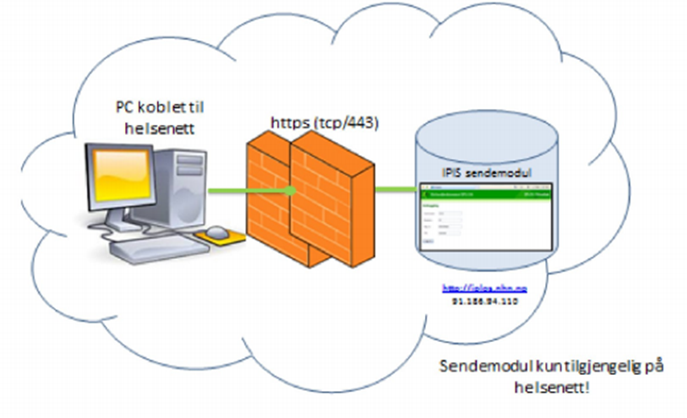
Burden of reporting - What’s in it for us?
Burden of reporting – experienced feeling of “cost – benefit” – two central dimensions
Automatized file extraction of information we have to register anyway to secure proper proceedings or good management
Access to the result of the data collection at an appropriate level and form
ease analysis of development over time for our municipality
suitable for benchmarking
National level
(Statistics Norway, Directorate etc)
Recieves data
Quality assurance and follow up questions
Publishing aggregated data on national, regional and local level
If users are less then 5 – no publishing.
Municipal administration
QA of the data
Opens for sending through encrypted channel
Journal system
Information about the user necessary for proper services
Decisions on services
Other information necessary for proper delivery of services
Safe zone
Individual data
Municipal o perational level

Slide 23
The cooperation in KOSTRA between Ministries, Municipal organization og Statistics Norway also provides a cost-effective solution
Ensure joint ownership to the project
Statistics Norway’s collection and quality assurance of data ensure proper reporting and transparency. Possibilities to use the infrastructure and data acquisition expertise of Statistics Norway
The cost of Kostra:
Ministry of Local Government and Modernization financed the development of Kostra in the late 1990’s and early 2000’s (about 11 mill. NOK yearly)
In 2002, when Kostra was implemented, the budget of Statistics Norway budget was increased with NOK 13 million. This appropriation is later incorporated in Statistics Norway’s block grant.
Modernization of KOSTRA in 2016-2017 had a budget of 80 NOK millions. (financing shared between Ministry of Finance, Ministry of Local Government and Modernization and Statistics Norway)
Notes:
Ownership - understanding of the necessity of reporting.
Data from Kostra is published on Statistics Norways ordinary platform.

Slide 24
Kostra - summarized in key words
Standardized reporting - better quality.
Data from all municipalities are available.
Comparability- compare services – benchmarking
A better tool for planning
Focus and challenge for the future is to exploit the favorable situation and the possibilities that KOSTRA gives

Slide 25
Common accounting rules – success factor
Municipality accounting – have to take into account both internal and external needs
accounting string and flexible financial IT systems
KOSTRA Classification by Function, example Kindergarten:
201 Kindergartens
211 Extra care for children in kindergartens
221 Localities and transport for children in kindergartens
Classification by Types of Expenditure, ex:
010 Wages permanent employees
100..290 Expenses for services produced by the municipalities, ex, energy, teaching materials, maintenance, consultants etc. (purchase of services entered into own services)
370 Services bought from others (private companies, other municipalities or the state – replaces own services)
470 Transfers
Notes:
A little about the accounting regulations:
To be able to compare the key figures from one municipality to another we need standard classifications of the accounts.
The accounting system are dived in to different municipality services for example:
201 Kindergartens
211 Extra care for children in kindergartens
221 Localities and transport for children in kindergartens
Further the account is classified into different types of expenditure and revenues. Like type 010 wages.
By combining function and type we may say how much money each municipality spends on wages in kindergartens. And so on..

Slide 26
Divisions of services (municipalities)
A. Profile of needs B. Finances
(population, divorced, single parents, unemployed, etc.) (financial key figures, purchase of services, charges, etc…)
--------------------------------------------------------------------------------------------------------------
C. Kindergartens J. Nature and environment
D. Education K. Culture
E. Healthcare L. Church
F. Nursing and elderly care M. Transportation
G. Social services N. Housing
H. Child welfare O. Arrangement for trade
and business services
I. Water, sewage, disposal and refuse collection P. Fire and accident
R. Agriculture S. Employment
Notes:
Profile of needs and finances must be related to calibrated un the same dimensions.

Slide 27
KOSTRA – Reporting system
Resources
Man- labour year
Expenditures and revenues
Productivity
Public services
Recipients
Extent and frequency
Priority
Coverage ratios
User group
Population
Population characteristics
Notes:
This figure shows how we combine different types of information in the KOSTRA system to publish key figures for productivity, priority and coverage.
To publish this information we need data on:
Resource allocation – for example accounting data and personnel data
Data on services and users
Requirements – populations (for example data on children in the age 0..5)
This is meant to give central and local government necessary information to govern.
The information is also needed by the municipalities for planning and development purposes. The municipality can study the statistic over time and comparison them selves whit other municipalities.

Slide 28
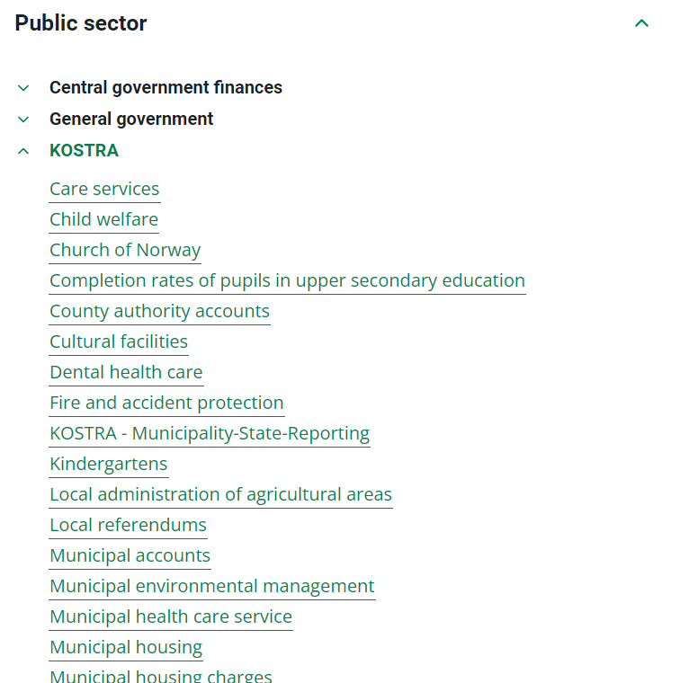
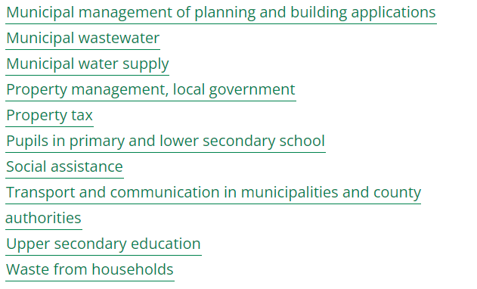
Information and data are available in Statbank of Statistics Norway
https://www.ssb.no/en/statbank/

Slide 29
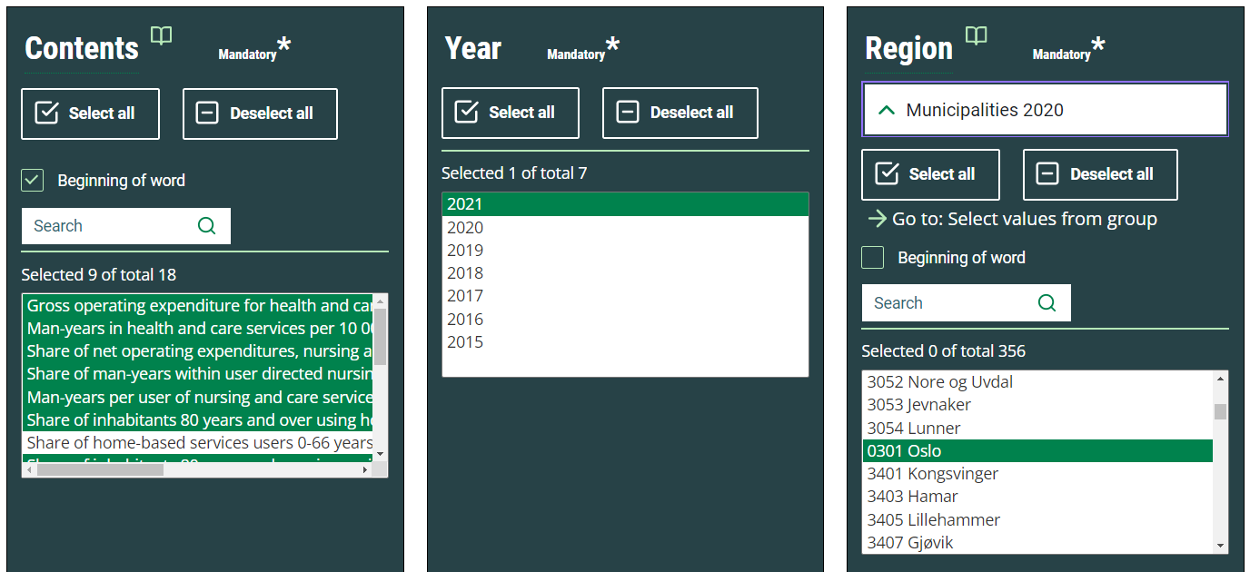
Key figures are easily accessible in Statbank, and they are easy to collect

Slide 30
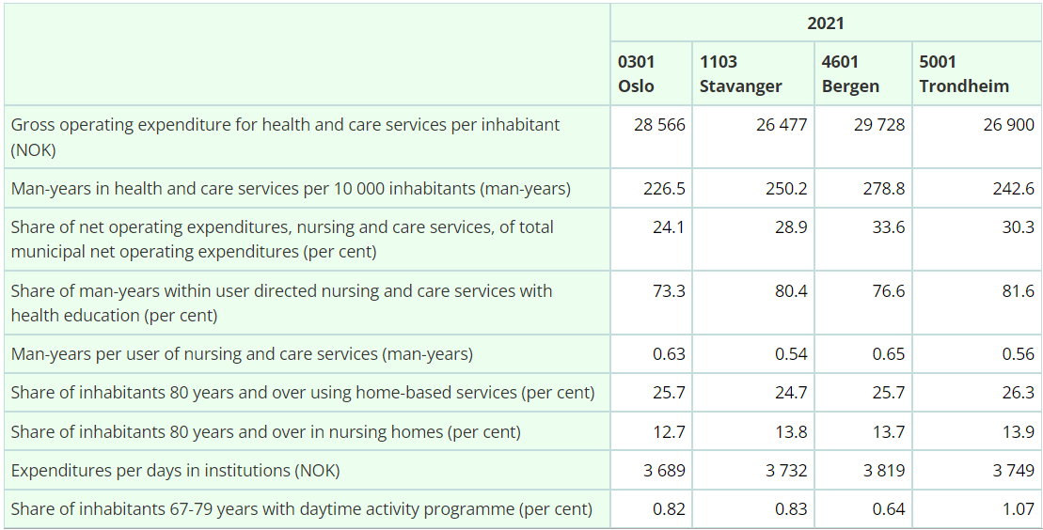
Key figures are easily accessible in Statbank, and they are presented in tables

Slide 31
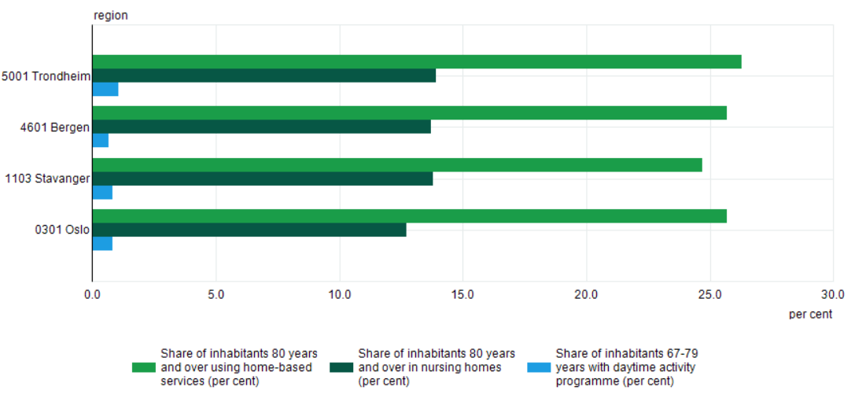
Key figures are easily accessible in Statbank, and they are presented in tables or bars

Slide 32
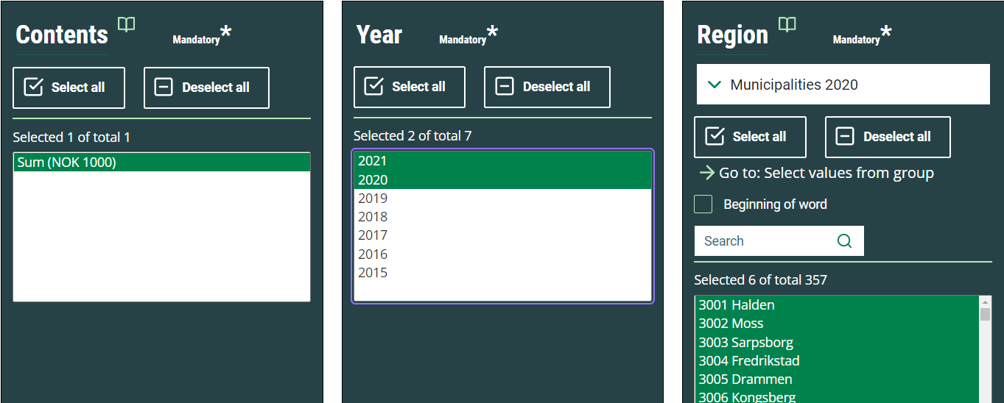
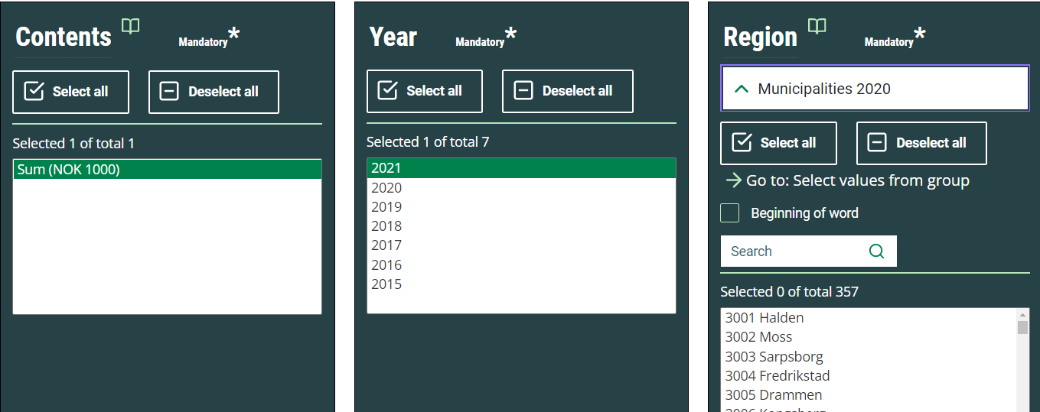
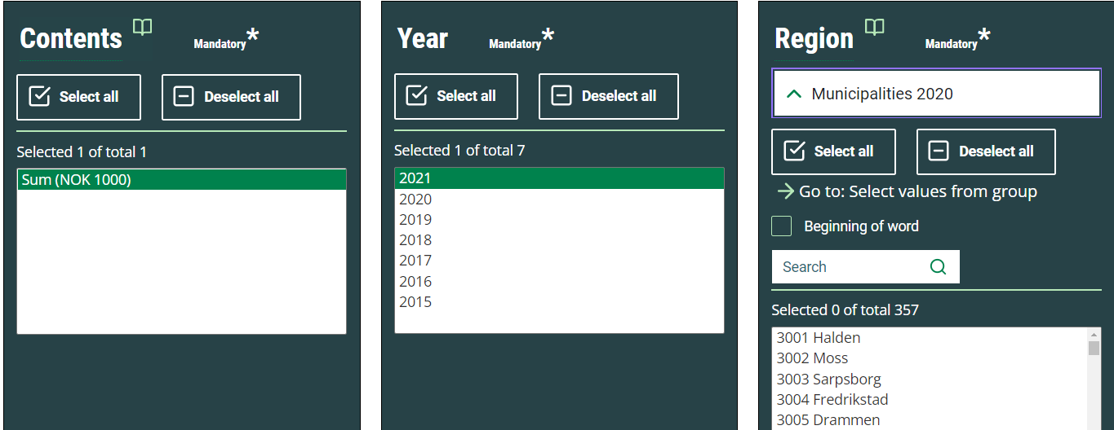
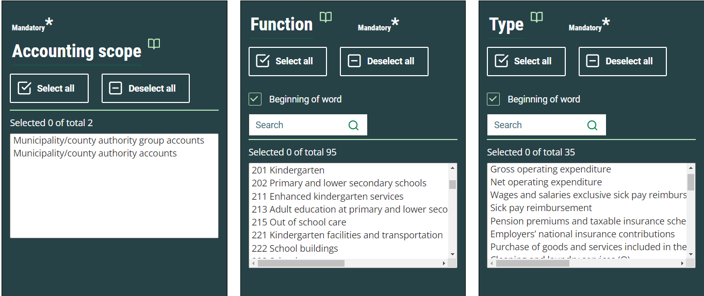
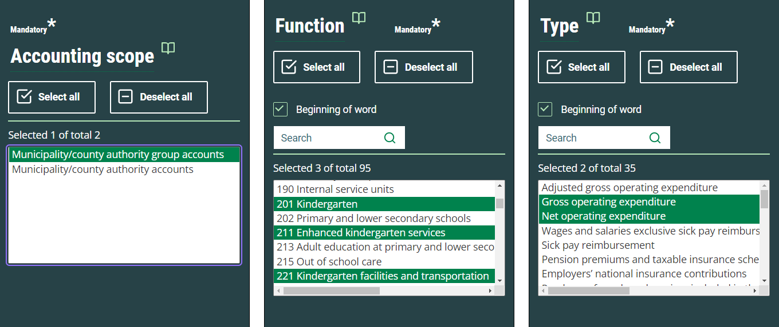
But maybe more important for expert users, detailed data is also available in the Statbank
12367: Detailed accounting figures in the operational accounts , by accounting scope , function and type (M) 2015 - 2021

Slide 33
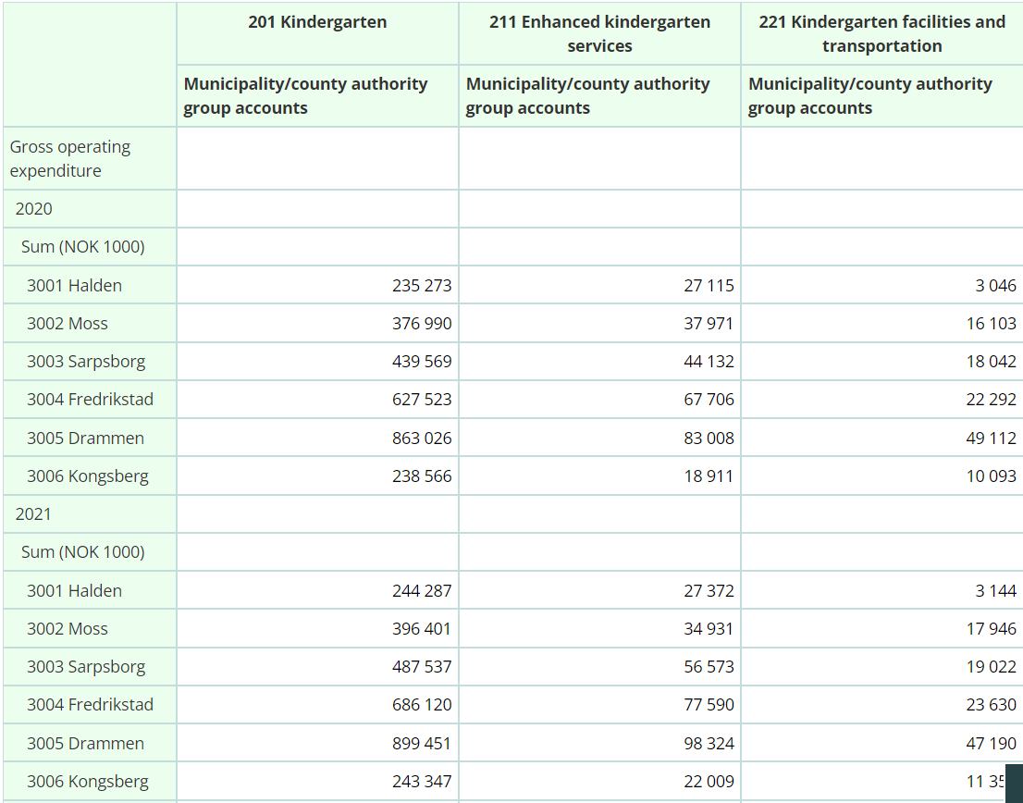
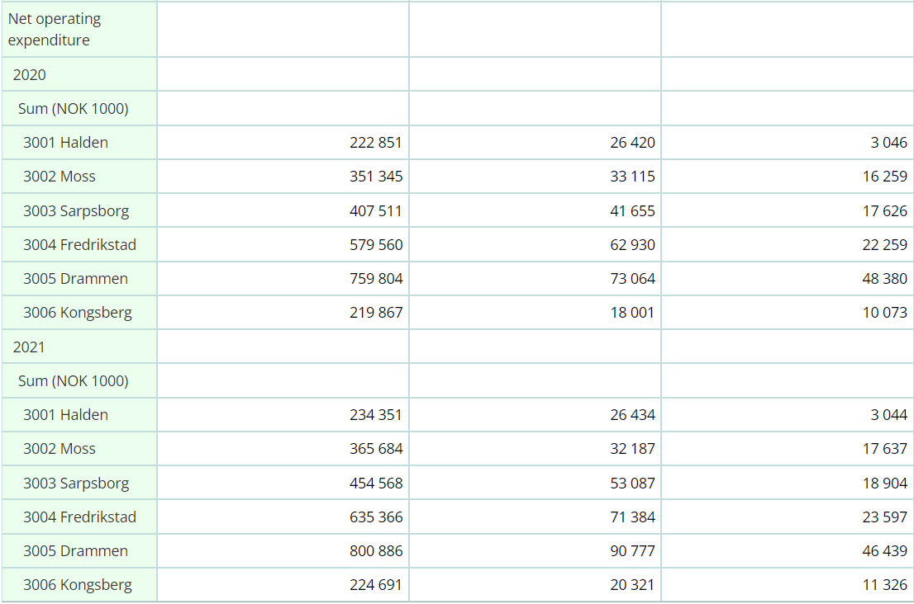
The first presentation of the results in a table isn’t that user friendly

Slide 34
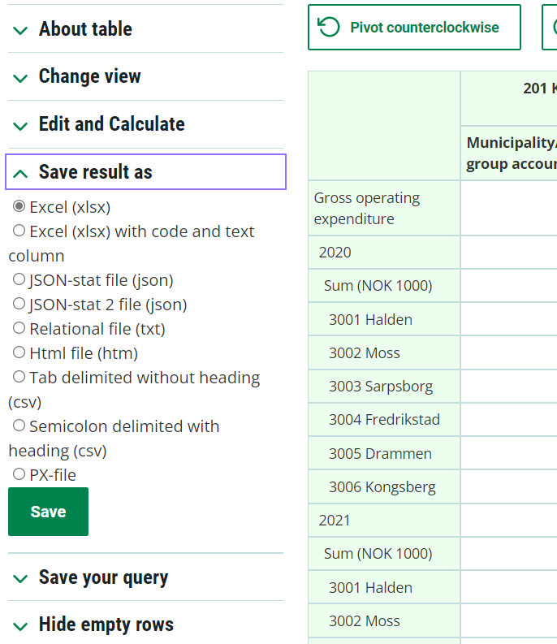
But it’s a lot of possible options for downloading

Slide 35
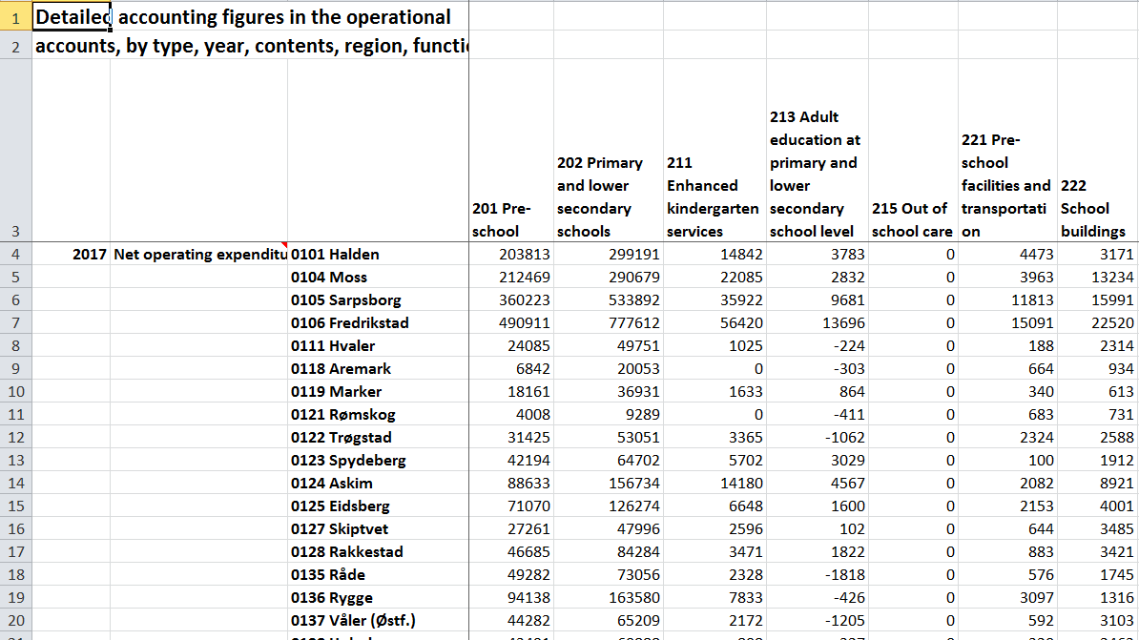
The open data gives possibilities for analysis Another example of available basic data – exported into excel
Notes:
Another advantage with the Statbank and the Kostra data; it’s very easy to export them to a spreadsheet as illustrated in the slide above. This gives a lot of opportunities for further analysis as we will come back to later.

Slide 36
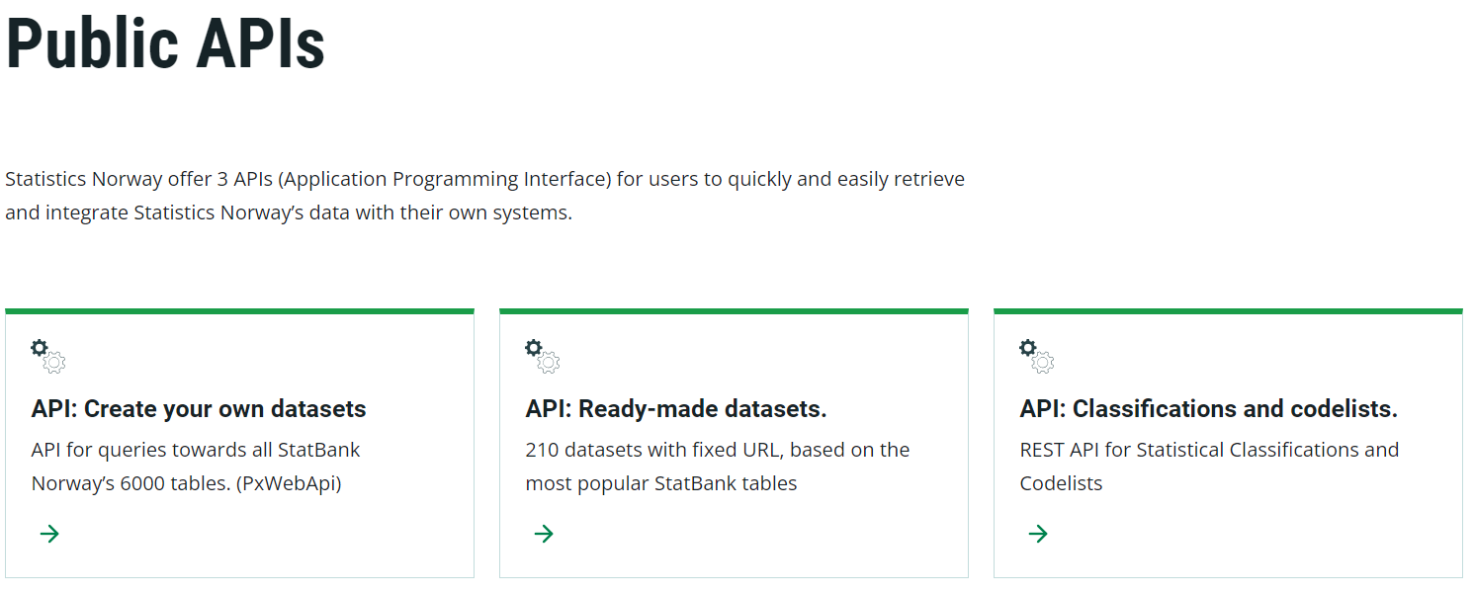
And even better – It’s not necessary to create tables in Statbank All data can be collected by using APIs
Public APIs - Statistics Norway (ssb.no)

Slide 37
Example of use - municipalities
Discussion of development and status in municipalities annual reports
Comparing with other municipalities – analysis/benchmarking of specific areas
Strategic planning and annual budgeting – development of targets

Slide 38
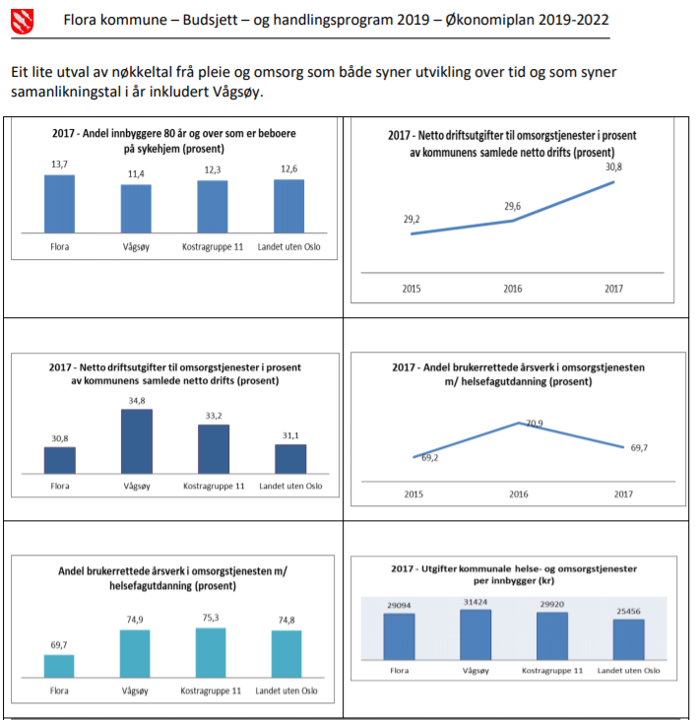
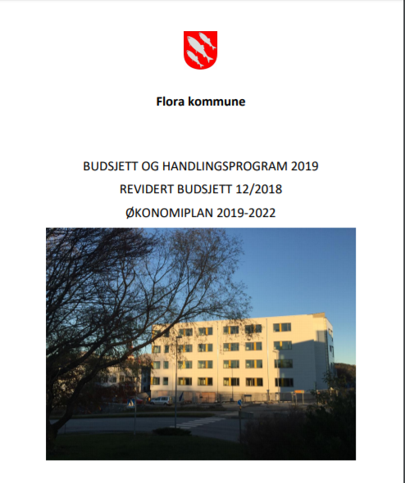
Example of use of KOSTRA in municipalities - Flora
A small selection of key figures for nursing and care services
Four year Finance Plan and next years budget – CEO proposal to the Community Council’s executive committee
Notes:
I’ll start with an example from the budget document of Flora municipality with a 4 year action plan. Flora is a municipality with 12 000 inhabitants. In 2020 they amalgamated with Vågsøy who has 6 000 inhabitants. I’ll think it’s therefore key figures from these municipalities are compared. In addition Flora is comparing their key figures with Kostra group 11, which includes municipalities of same size, with equally income and level of expenditure needs as Flora.
The first bargraph, upper left, shows the share of inhabitants 80 years and older living in nursing homes, which in general is the most expensive service for elderly people. Flora has a fairly high indicator, but it doesn’t tell us if this is a result of particular characteristica of the population in Flora or municipal priorities. It’s also interesting to recognize that Vågsøy, the municipality Flora is going to amalgamate with has lower coverage ratio of nursing homes compared with the numbers of inhabitants over 80 years.
The other bargraphs contains information about (but I’m not going comment them):
Middle left: Net operating expenditures for nursing and care services as part of total net operating
expenditures
Down left: Share of user oriented fulltime equivalents with health care education (percent)
Dow right: Expenditures in municipal health, care and nursing services per capita
There are also two line charts, used to illustrate the development from year to year. In the upper left chart shows growth in net operating expenditures for nursing and care services as part of total net operating expenditures. And even that I didn’t find an explicit explanation in connection with the figure, Flora municipality has a fast growing elderly population also as part oft the total population and this is a possible reason for the growth in the expenditures.
The second line chart shows the development share of user oriented fulltime equivalents with health care education

Slide 39
Another excample from Oslo:
Use of KOSTRA in local governance
Budget-process
Capacity planning of different services
Status
Forecasting
Efficiency
Comparing/benchmarking – with other cities and between city districts
Political – measuring political pledges

Slide 40
Oslo compared with the 10 biggest municipalities (primary health)
Green is directly from Kostra, Red – other sourches/manual reporting, Purple – Resource use indicator

Slide 41
Example III Benchmarking city districts
Number of users per 1000 inhabitants/1.1.2017

Slide 42
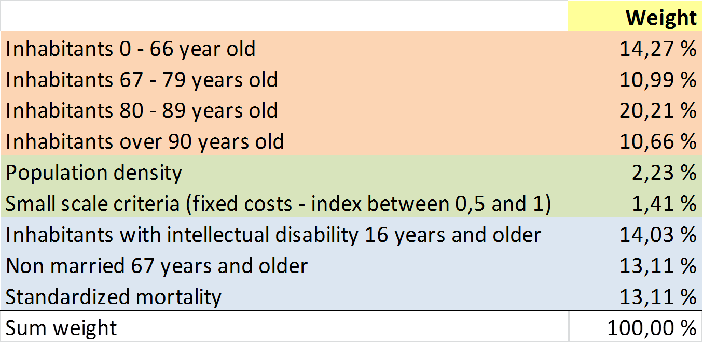
Example of use – government
Statistical analysis, for example in the General Grant system and the expenditure equalization mechanism
Information on how municipalities prioritize, for example in relation of national aims
Nursing and care services – expenditure equalization key

Slide 43
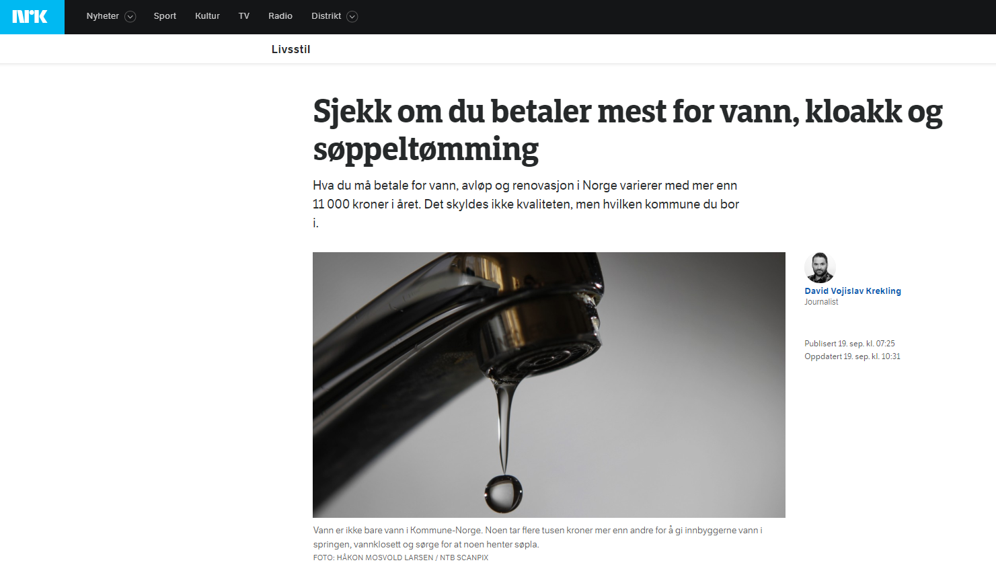
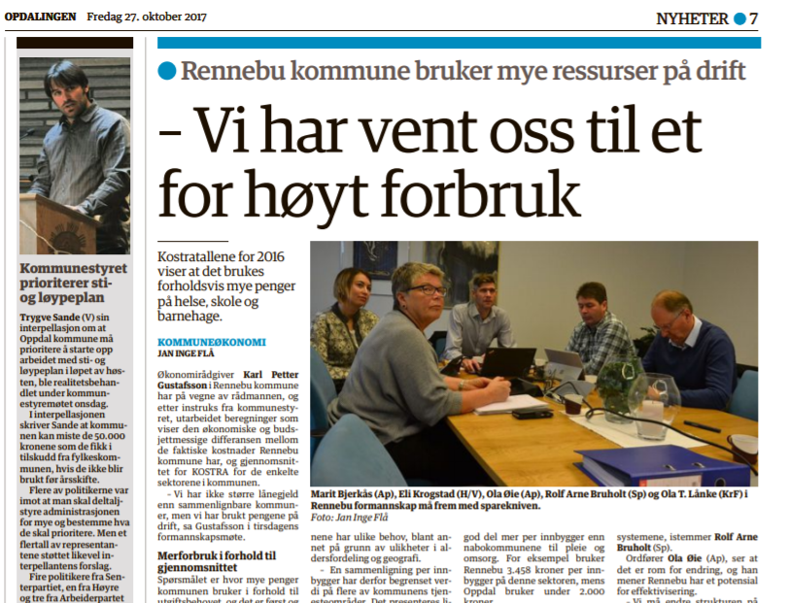
National media:
Check if you pay the most for water, sewage and garbage disposal
Lokal newspaper: The municipality has got used to overspending

Slide 44
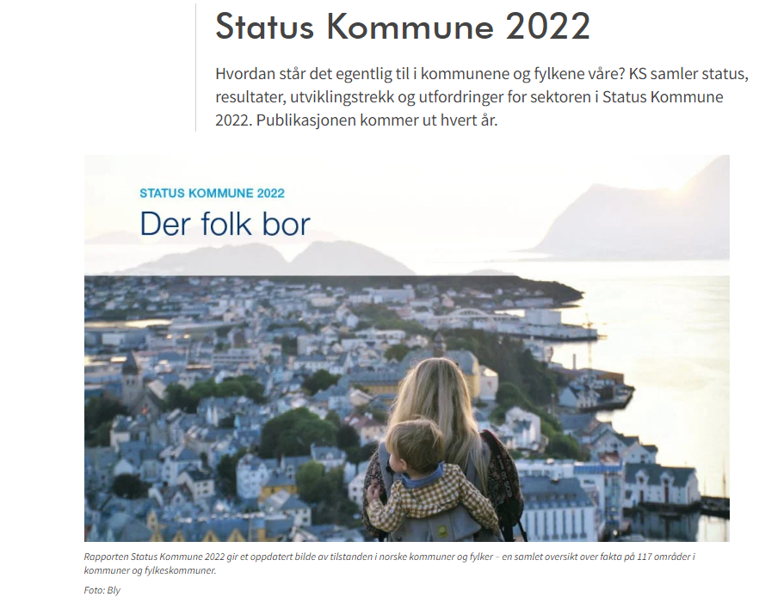
https://www.ks.no/
Notes:
Municipality status

Slide 45
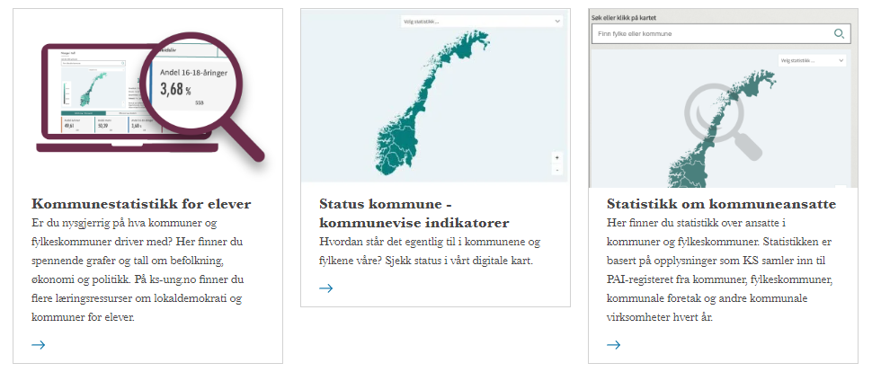
https://www.ks.no/nye-kartregioner/norge-i-tall/
Notes:
Norway in numbers
Municipality status - municipal indicators

Slide 46
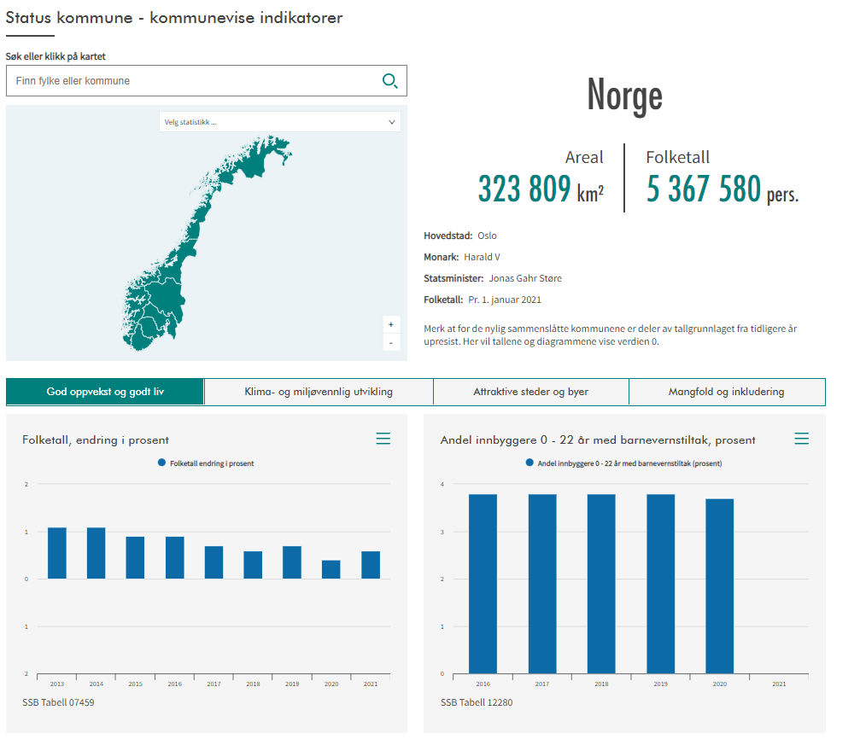
https://www.ks.no/status-kommune/kart/

Slide 47
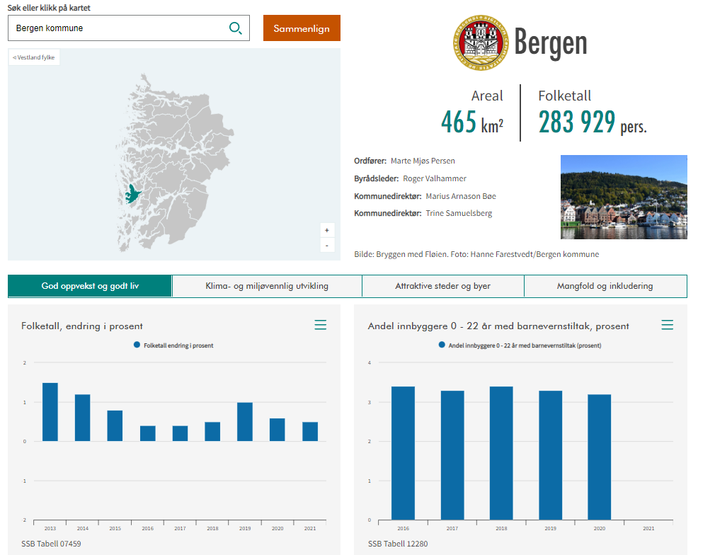
Notes:
Child welfare measures

Slide 48
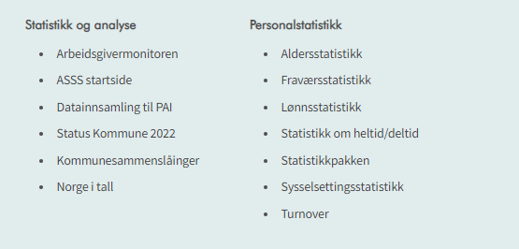
Notes:
Statistics and Analysis

Slide 49
ASSS – KS-Network between the 10 of the most populated municipalities
Aim
Improvement of the local government services
Means
Learning by comparison
Benchmarking budgets and services
Learning from best practices / good examples
Organization
Steering group:
City managers
Program committee:
Managers of economic departments
Network for 9(?) different services:
Experts/professionals from the services
Economists

Slide 50
Contributions from KS
KS delivers annual reports
Financial statement analysis
Analysis of differences in expenditure, priorities, production and efficiency
Detailed analysis for each service
KS is «running» all groups / networks
Aims of the economic analysis in ASSS
A coherent analysis:
The municipality’s possibilities
Differences in income
The municipality’s priorities
Differences in computed expenditure needs
The municipality’s outcome / production
Differences in efficiency (value for money)

Slide 51
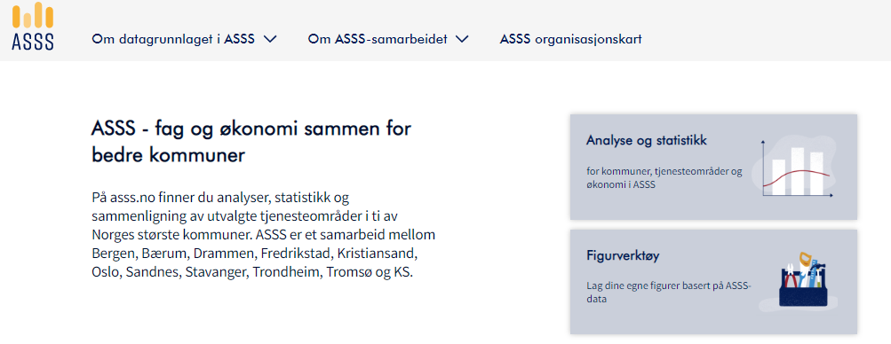
https://www.ks.no/asss-hjem/

Slide 52
Notes:
ASSS overall
Resource use, production and efficiency

Slide 53
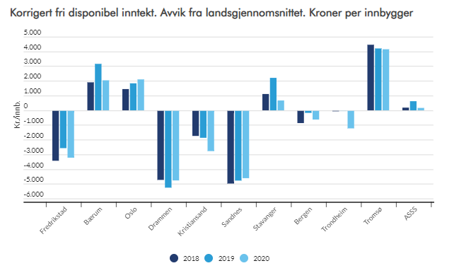
Adjusted free disposable income. Deviations from the national average. NOK per inhabitant

Slide 54
Notes:
Resource use, production and efficiency

Slide 55
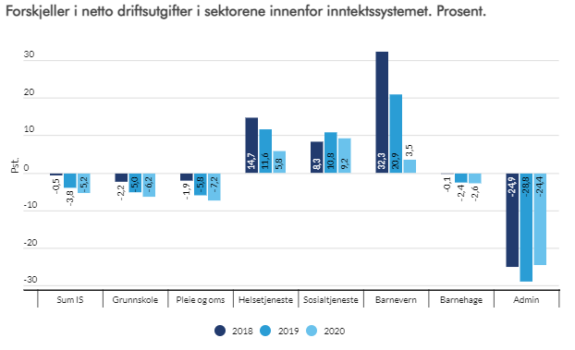
Differences in net operating expenses compared with expenditure needs. Percent.
Grunnskole – Primary and lower secondary school Pleie og omsorg - Nursing and elderly care
Helsetjeneste – Healthcare
Sosial tjeneste - Social services
Barnevern - Child welfare
Barnehager – Kindergarten
Admin - Administration

Slide 56
Nursing and care services: Deviation between actual expenditure and expenditure needs NOK per inhabitant

Slide 57
ASSS: Nursing and care services – efficiency analysis

Slide 58
KS – Consultants (a subsidiary of KS)
KOSTRA-analysis provides the most important indicators in relation to analysis and management/governance set to:
How are the services prioritized?
What are the coverage-ratios; are the users needs met?
Presentation of some productivity indicators, with a discussion about what they explain / not explain
To create an overall profile for the services, we need to put KOSTRA-indicators together. The service profiles provide a good basis for asking questions about:
What is the possible «scope of action» for each service?
What characterizes «best practices»?
Notes:
KS consultant is a subsidiary of KS, which sells consulting services to municipalities, county municipalities and municipal companies in line with KS 'focus areas.
And here is what they emphasize as advantages of Kostra.

Slide 59
KOSTRA is, as far as I know, quite unique in a European context
Poland. Developing a future public performance system which has commonalities with KOSTRA.
High quality data collected from currently dispersed sources
Enabling access to comparable data for benchmarking for different actors
Analysis in four dimensions: quantity of service delivery, quality of service, availability to citizens and cost effectiveness
Sweden The municipal association publishing similar data. But they have to collect them from dispersed sources, among them Ministries.

Slide 60
Methodology for data visualization and technical specification for IT tools

Slide 61
Tools
We use KOSTRA and data from other sourches in many ways:
Standardized data creates opportunities
Time-series (see long time trends)
Status today (or at least last year)
But important to do some manual quality assuranse as well…
Excel
PowerBI
Highcharts
Tableau
Infogram
…

Slide 62
Example I: Nordic countries
Example
– Demographics in the Nordic countries
Data from ssb.no and other Nordic Countries
From tables infogram for publishing online and other uses

Slide 63
Example II
Demographic changes (comparing municipalities)
(example from «Status kommune»)
Standardized data from ssb
Created in PowerBI (previously Tableau)

Slide 64
Age dependency ratio (we prefer population aged 0-22 and 67 and older vs population aged 23-66)
Change year

Slide 65
Groups and control-fields
Metadata (municipal identifyer, year etc.)
Data
Calculated columns

Slide 66
Another example
https://www.ks.no/asss-hjem/asss-2021/artikler/okonomi/asss-samlet/fremtidig-utvikling-i-utgiftsbehov/
Excel (tables and calculations) Infogram asss.no

Slide 67
Example 4
Differences in income base, expenditure needs and use of resources:
Some of the data automated
Some manual calculations and
Import to HighCharts, Infogram and/or PowerBI
https://www.ks.no/asss-hjem/asss-2021/artikler/okonomi/asss-samlet/forskjeller-i-inntektsgrunnlag-utgiftsbehov-og-ressursbruk/

Slide 68
Last example
API from Kostra/SSB
Sql-server
Semi-automated online publishing
(QA)
intermediate storage
does calculations
API out
Fully automated
Municipal health services (ten biggest municipalities)
https://www.ks.no/asss-hjem/asss-2022/artikler/tabeller-og-figurer/asss-samlet/asss-samlet-kommunehelse/
Or accounting analysis (municipality of Drammen)
https://www.ks.no/asss-hjem/asss-2022/artikler/okonomi/drammen/regnskapsanalyse/

Slide 69
Manual data input
Our own projects - no public data source
Project managers adds data into an Excel-sheet
PowerBI gets input from excel-file and creates visualization (in this case: map and counter)
https://www.ks.no/fagomrader/digitalisering/felleslosninger/digitalisering-i-helse-og-omsorgsektoren-e-helse/ks-kompetansenettverk-for-e-helse-ks-e-komp/kjernejournal-i-sykehjem-og-hjemmetjeneste/

Slide 70
Extra: Compare countries
Eurostat for comparing countries
Download data and further processing (Excel/powerBI/Infogram etc.)

Slide 71
Thank you for your attention

